Slide 1
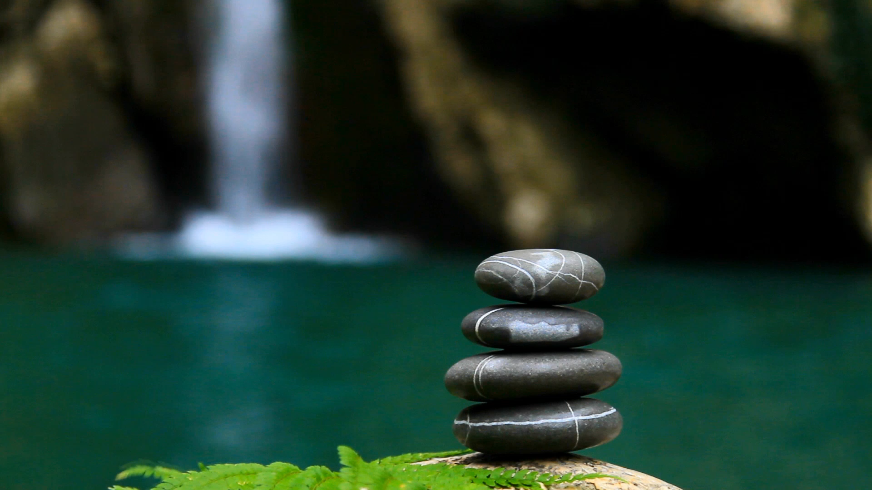
Wellbeing and Self-care.

Slide 2
Mental health definitions
There are different definitions of mental health but most agree that it is about our thoughts and feelings, and how we behave.
The World Health Organisation describes mental health as:
‘A state of wellbeing in which every individual realises his or her own potential, can cope with the normal stresses of life, can work productively and fruitfully, and is able to make a contribution to her or his community.’
NHS England describes mental health as:
‘How we think, feel and behave’.

Slide 3

Thinking about mental health
Mental health can be thought of as a scale that can move up or down, a bit like a thermometer.
We can move along the scale at any time, between being healthy or unwell.
There are things we can do to help us stay healthy.
There are things that can be put in place if someone is not feeling so good, is struggling or unwell.

Slide 4
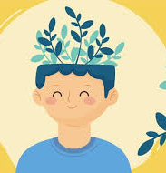
Improving children’s wellbeing
Identify and understanding feelings and emotions
Developing a growth mindset.
Mindfulness activities.
Positive health activities.
Developing coping strategies.
Positive self-talk skills.

Slide 5
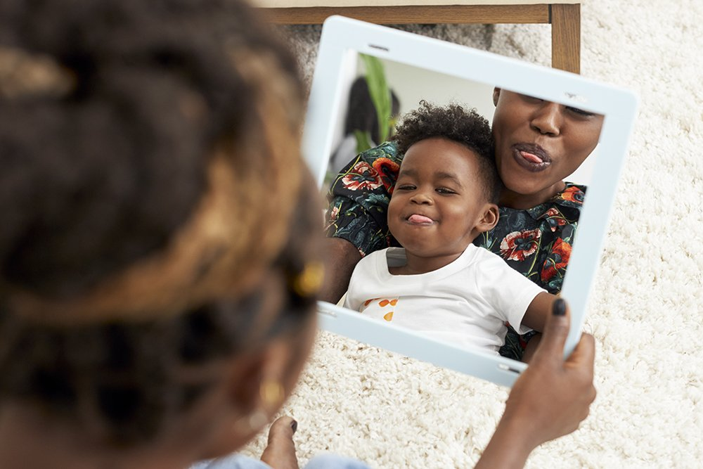
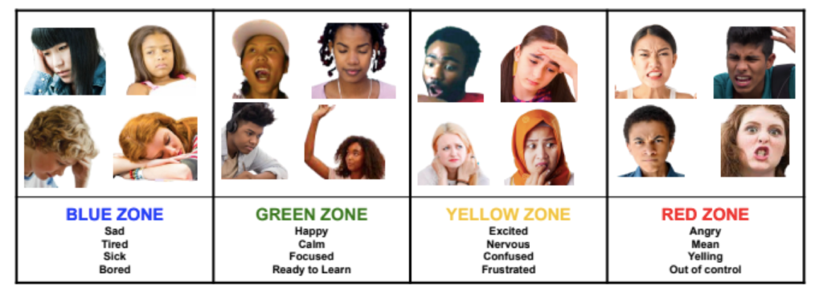

Identify and understanding feelings and emotions
Mirror activity
Zones of regulation.
Stories – discussing characters feeling and emotions .

Slide 6
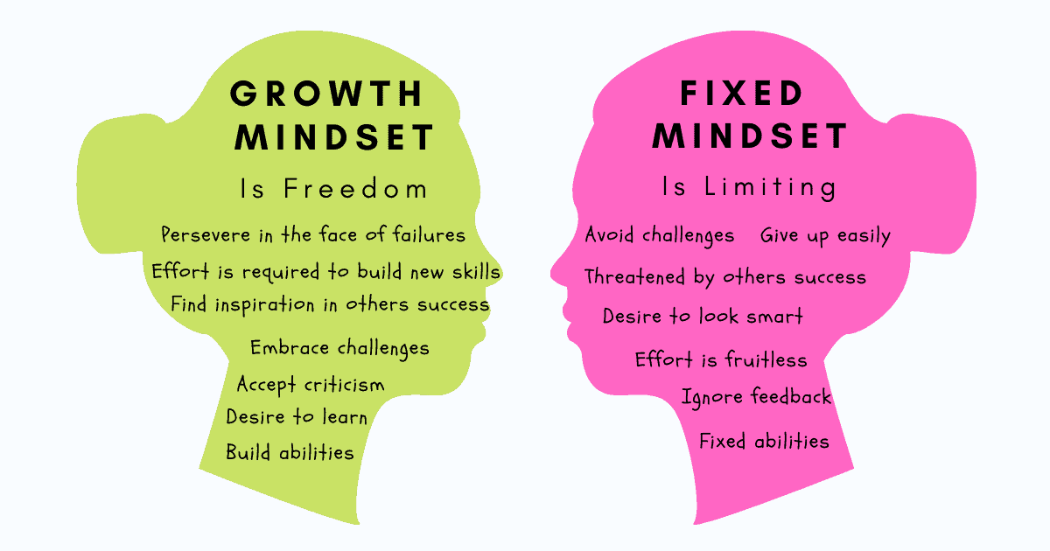
Developing a growth mindset.

Slide 7
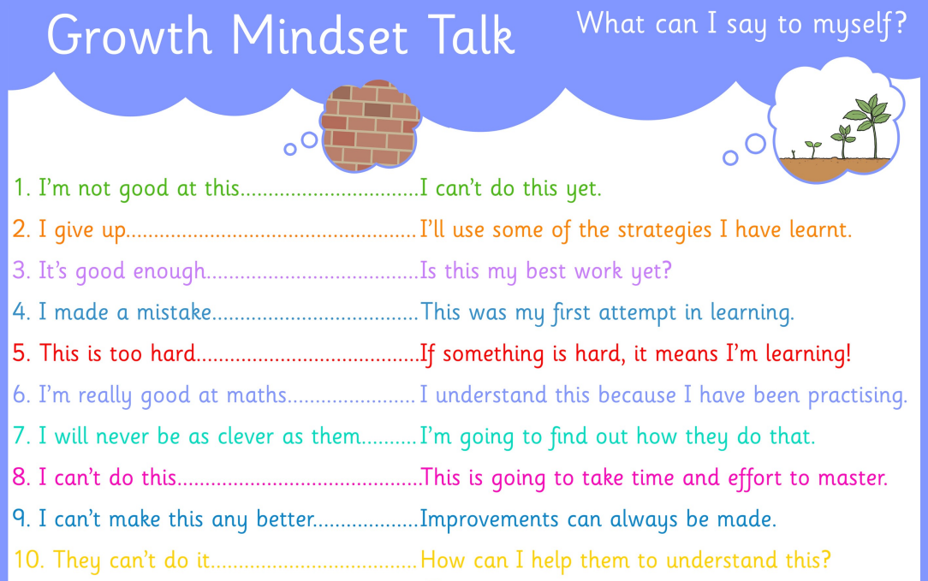
Developing a growth mindset

Slide 8
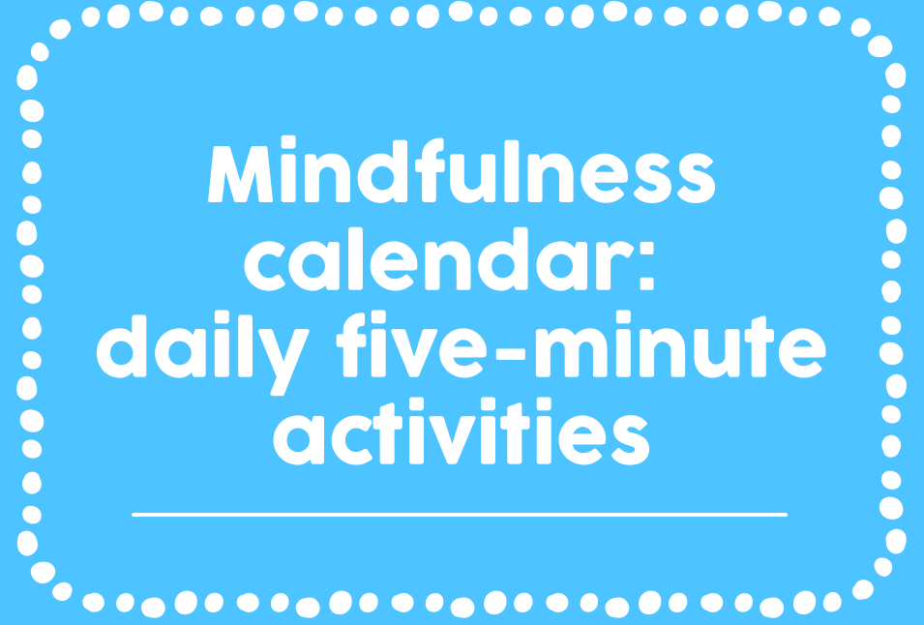
Mindfulness activities.

Slide 9
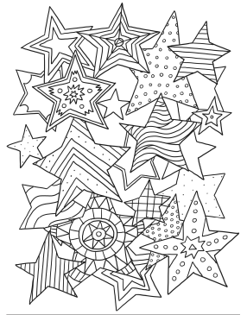
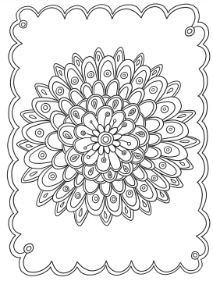
Mindfulness activities.
https://www.youtube.com/watch?v=UEuFi9PxKuo
https://www.youtube.com/watch?v=Fu6XOe6SwHI
https://www.youtube.com/watch?v=L3Dp4oGkn3k

Slide 10
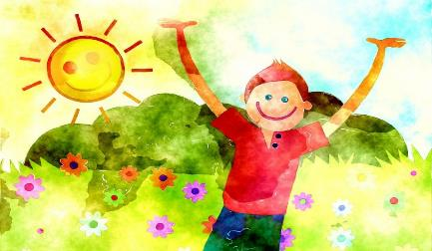
Positive Health Activities
Chatting to friends Stroking a pet Drawing, painting, music Watching a funny film Learning something new Expressing your feelings Reading a good story Playing games Thinking of happy times | Balanced diet Drinking water Keeping your body clean Rest, relax, quiet time Getting enough sleep Going for a walk Talking to a trusted adult

Slide 11

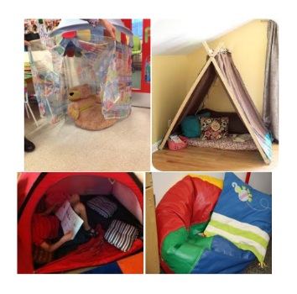
Coping strategies
Developing a calming area at home.
Social Story on Calming Down

Slide 12
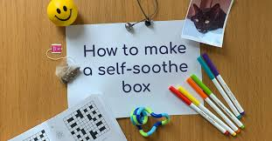
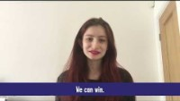
Coping strategies

Slide 13
Coping strategies.
BLOWING BUBBLES—this can have a very calming effect on children as blowing encourages your child to practice deep breathing.
PLAYING WITH PLAYDOUGH—engages the children for a long time. Include some calming smells such as lavender into the playdough.
HOLD TIGHT—give your child a squeezy ball or cuddly toy as this can help your child release all that tension.
PLAY SOME MUSIC—particularly calm music. Get your child to sing along as this can soothe and release tension
TALK A WALK OUTDOORS—green spaces can be particularly calming
HUG IT OUT—give your child a comforting hug as this will help your child feel safe and loved.
STRETCH IT OUT—help your child to stretch their aims above their head, stand on their tip-toes. Help your child stretch as tall as possible, then flop back down. Show them how to stretch out like a cat or reach up to the sky
CLOUD SPOTTING—lie on the ground with your child and encouraging them to stay as still as possible while you watch the clouds go by. See if you child can spot any shapes among the clouds.
RELAX WITH CBEEBIES RADIO—relax and listen to calming music. CBeebies radio has relaxing sounds such as waves,

Slide 14
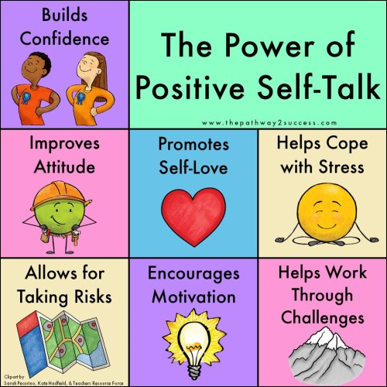
Positive self-talk skills.

Slide 15
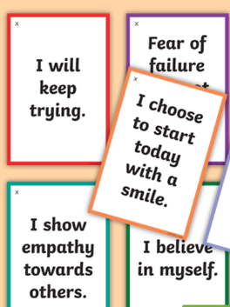
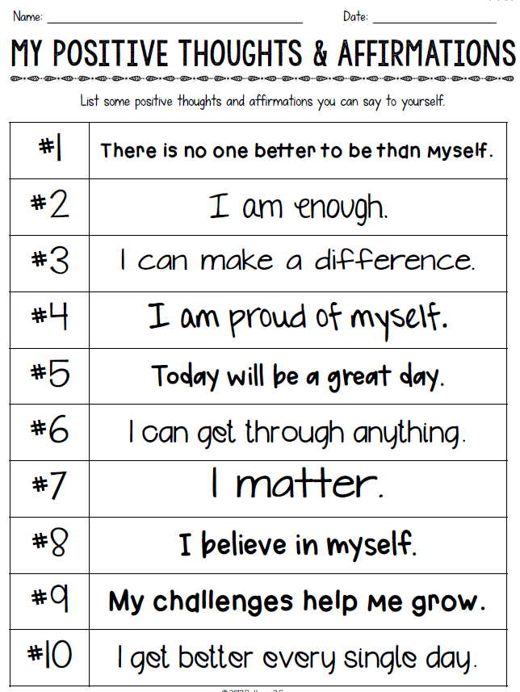
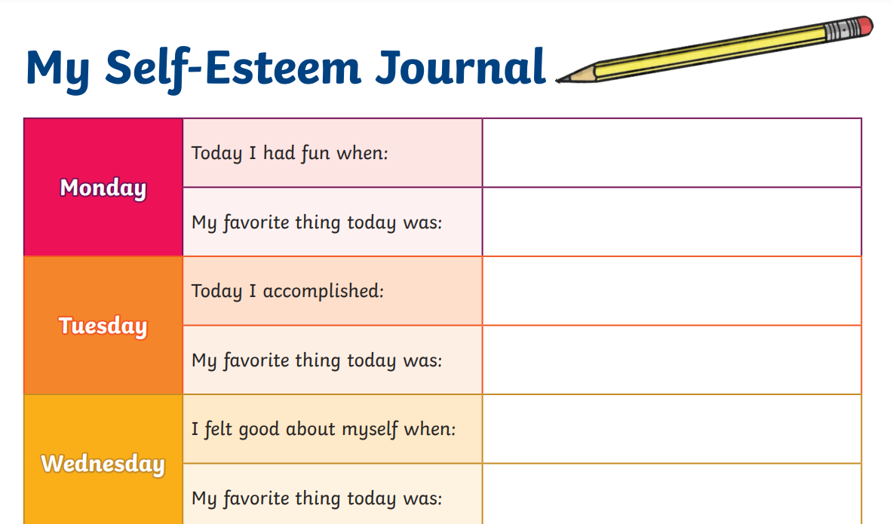
Positive self-talk skills.

Slide 16
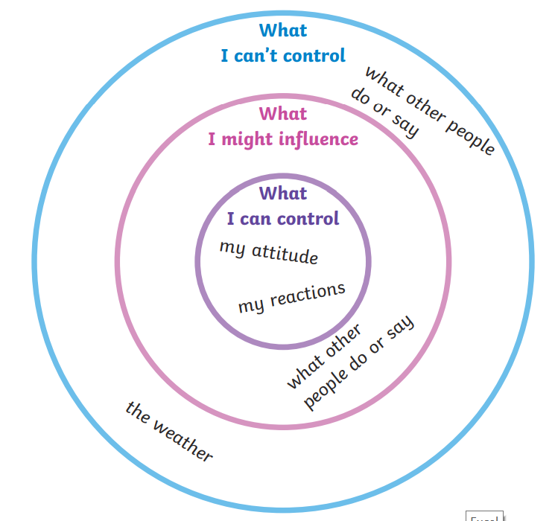
Circle of Control

Slide 17




Useful websites
https://www.youngminds.org.uk/
https://www.happymaps.co.uk/
https://www.kooth.com/
https://www.mind.org.uk/

Slide 18

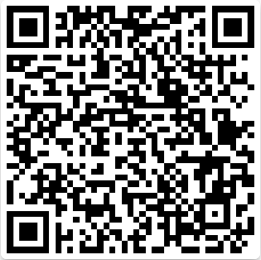
Any Questions
Please complete the quick survey below:

