Slide 1

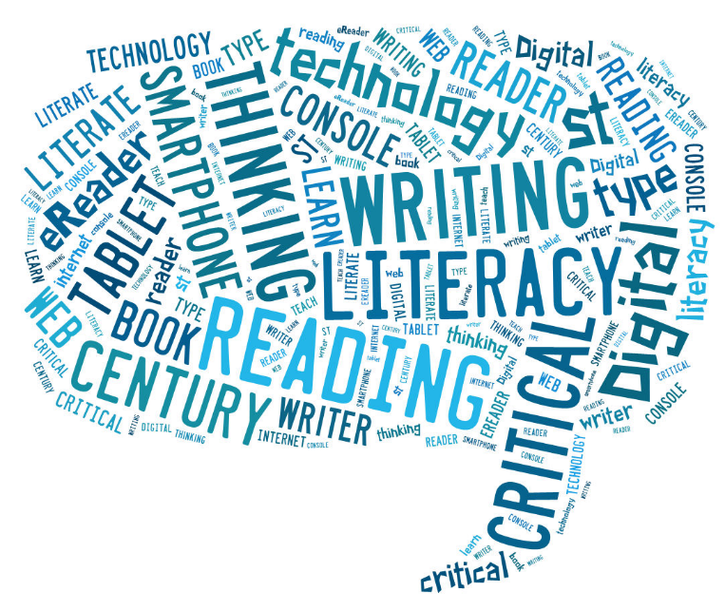

Supporting Literacy Skills at Home

Slide 2
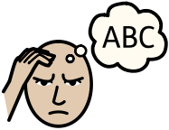
Definitions of Dyslexia
Dyslexia is a learning difficulty that primarily affects the skills involved in accurate and fluent word reading and spelling.
Characteristic features of dyslexia are difficulties in phonological awareness, verbal memory and verbal processing speed.
Dyslexia occurs across the range of intellectual abilities.
It is best thought of as a continuum, not a distinct category, and there are no clear cut-off points.
Co-occurring difficulties may be seen in aspects of language, motor co-ordination, mental calculation, concentration and personal organisation, but these are not, by themselves, markers of dyslexia.

Slide 3
How does this present?
Most will have some level of:
Difficulty with reading, spelling and writing – require intervention/adjustments
Processing speed difficulty– need extra thinking time
Memory difficulty: difficulties with working and sequential memory – require strategies to support memory.
Other areas of difficulty may be:
Aspects of co-ordination (left right confusion, clumsy, poor organisation skills )
SELF ESTEEM

Slide 4

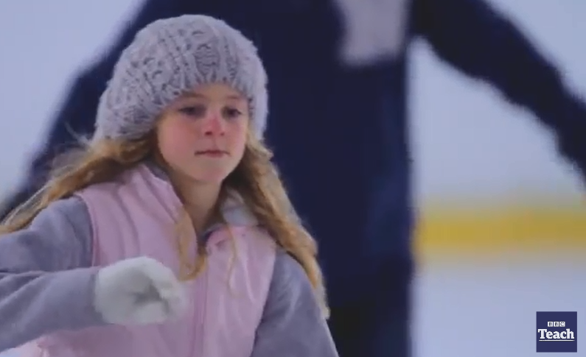
Sophie’s Story

Slide 5

Resources to support literacy difficulties

Slide 6
Children who read for pleasure make more progress in maths, as well as vocabulary and spelling, between the ages of 10 and 16 than those who rarely read.
(Institute of Education, University of London, 2013).

Slide 7




Practical Strategies
Reading | Writing | Talking & Listening
Newspapers | Write for an audience
Dictionaries | Diary, stories, poetry, song lyrics to deal with emotions
Subject specific books/magazines/blogs | Proof-reading
Reading to younger siblings | Find new words in reading; use new words in writing | Audiobooks; radio
Read together | Positive feedback | Verbal summarising
Computer homepage |  | Let your child teach you something
Question sources of information |  | TV adverts
All reading is good reading! |  | News & current affairs

Slide 8
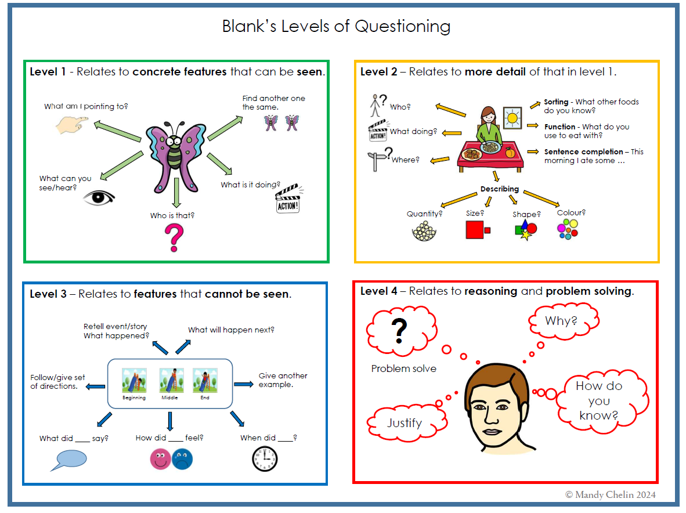

Slide 9

Reading with your child
Research has shown that reading aloud to children of all ages helps them to develop their writing skills. This is because it helps pupils to develop their knowledge of language and story structure.
It also provides them with a greater range of ideas which they can use in their own writing, and gives them access to texts that may be too complex for them to read alone.

Slide 10

Fostering a love of reading
It is also valuable for children to see adults enjoying reading themselves. Showing your child that you enjoy reading a book or newspaper yourself can help them to see the purpose of reading, and encourage them to become a reader.
Other ways to engage children as readers include listening to audio books, visiting the library or a book shop to choose their own texts and sharing books with their siblings.
Reading should never be a chore. Helping your child to develop a love of reading now will help them to develop as independent readers as they get older.

Slide 11
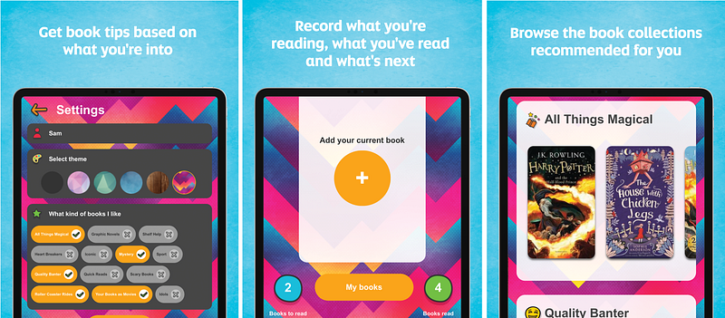


Useful Websites and Apps
The Scottish Book Trust has just launched the Bookzilla app, which encourages pupils to read for pleasure. Young people can receive tailored book recommendations, see what's popular among their classmates and challenge themselves to try something new with a reading dare.
http://lovereading4kids.co.uk is a fantastic website, where you can download the first chapter of thousands and thousands of books for free – a great way of helping your child find what they’re interested in.
http://readwritethink.org has lots of resources for parents to help develop literacy at home, such as games, tips and fun projects.

Slide 12


Any questions
Please complete the questionnaire using the QR code

