Slide 1

SEND Coffee morning
09.01.2024

Slide 2
Social, emotional and mental health difficulties
Children and young people may experience a wide range of social and emotional difficulties that manifest themselves in many ways. These may include becoming withdrawn or isolated as well as displaying challenging, disruptive or disturbing behaviour
These behaviours may include:
    anxiety/depression
    Self harming
    Substance misuse
Or
    ADD
    ADHD
    Attachment

Slide 3

Dysregulation
If you have self-regulation, it means you are able to regulate your own response to a situation in terms of your behaviour and emotions. Someone with self-regulation is able to understand how other people might be feeling and has developed inbuilt strategies to calm themself when they feel anxious. Their reactions are seen to be a reasonable response to the particular situation.
Dysregulation, is when someone is unable to control their response to a situation. It can cause great distress to that person. It can be caused by an inability to see a situation from another person’s perspective or difficulty in recognising emotions.

Slide 4
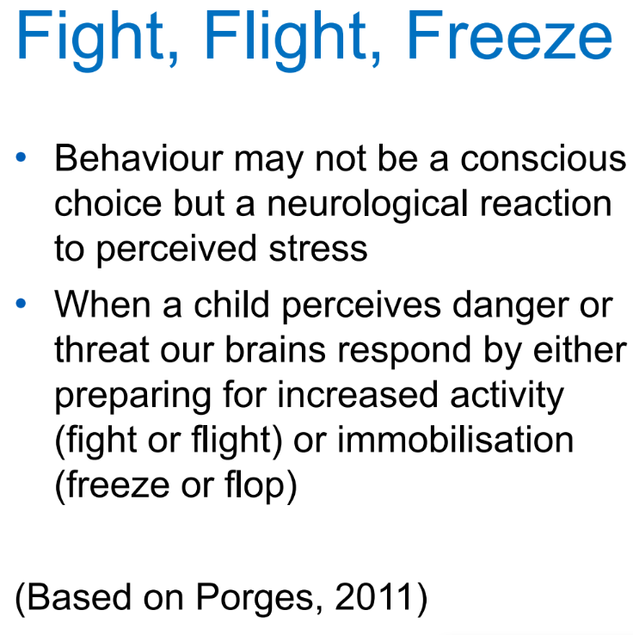
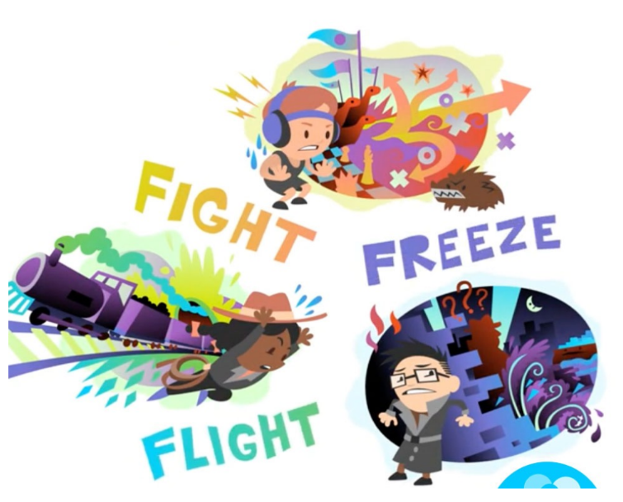

Slide 5
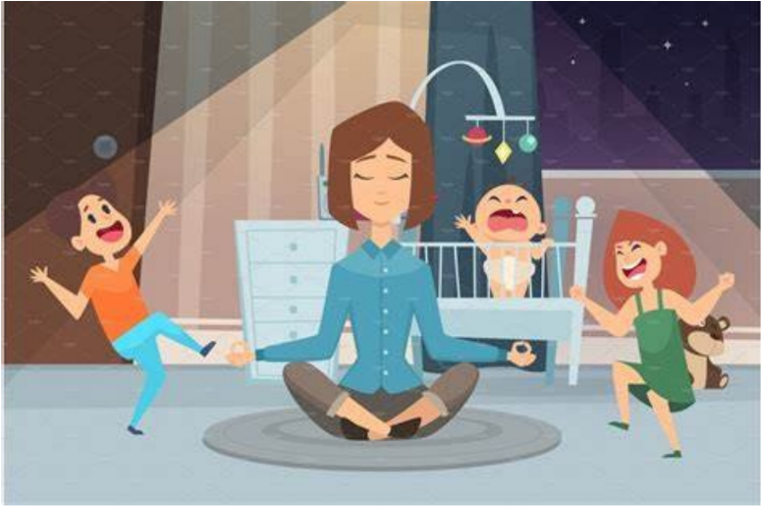
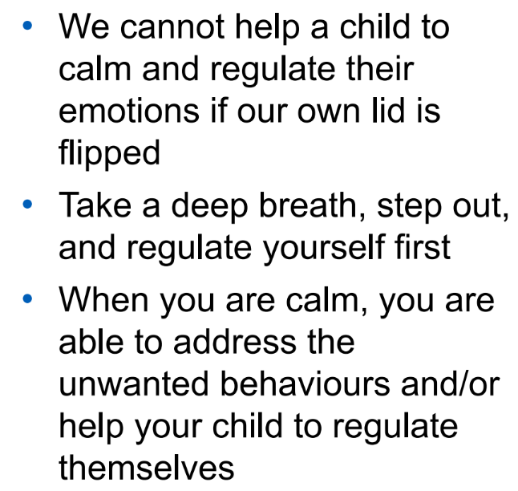
Regulate yourself first

Slide 6
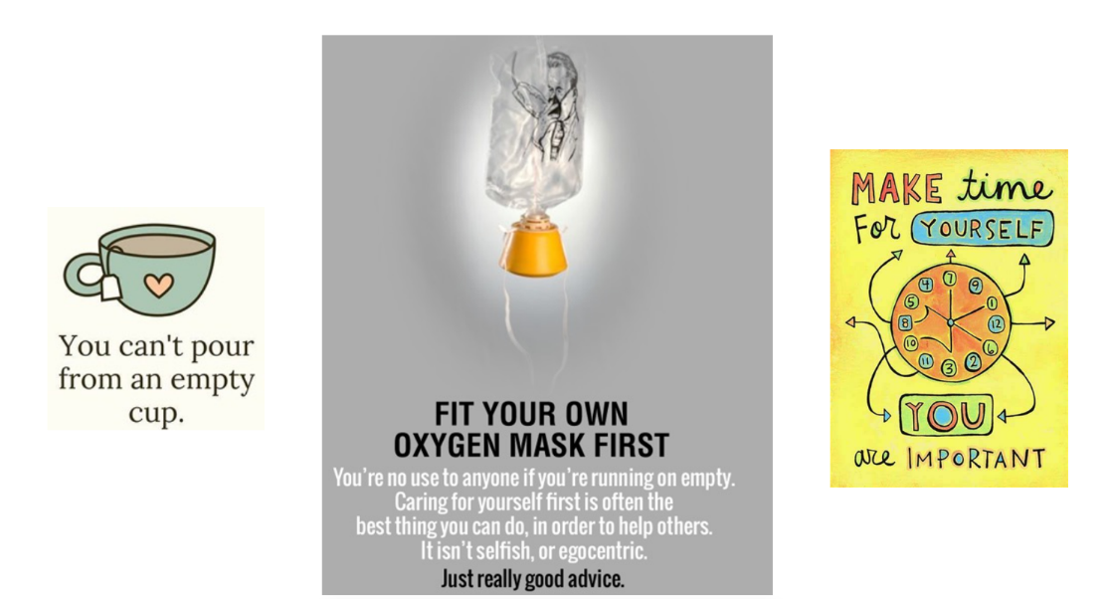
Self care

Slide 7
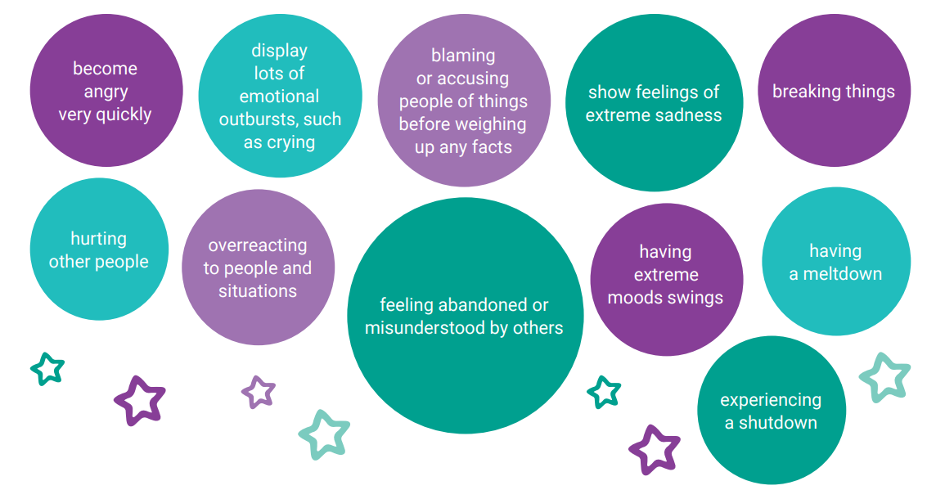
During a period of dysregulation, you might see your child:

Slide 8
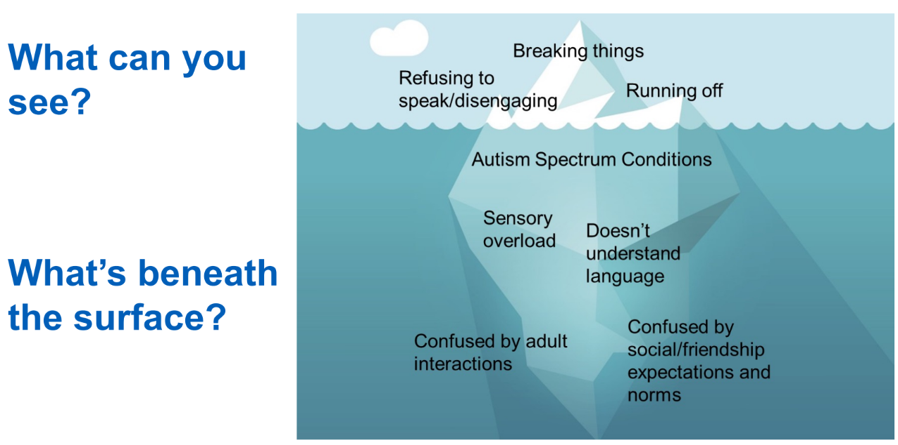

Slide 9
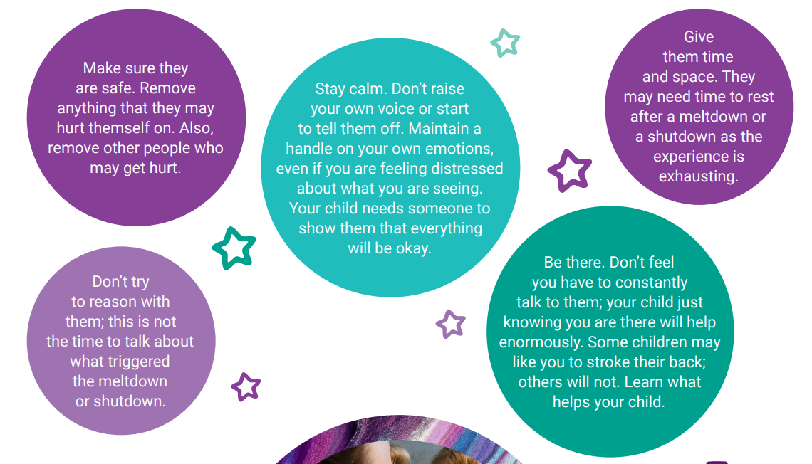
Each time your child experiences a meltdown or a shutdown, you’ll learn a bit more about how to support your child. Here are some things that might help them:

Slide 10
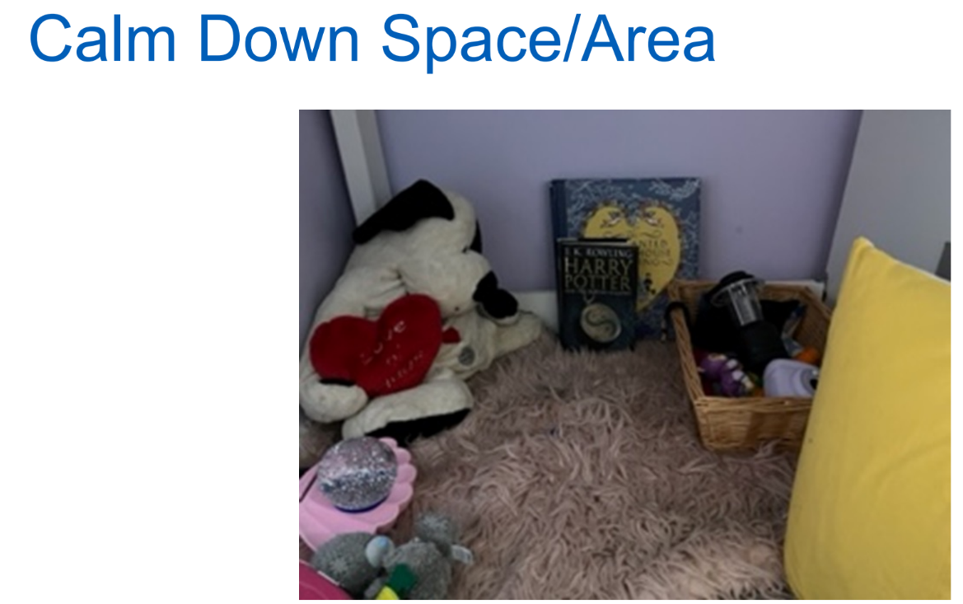

Slide 11
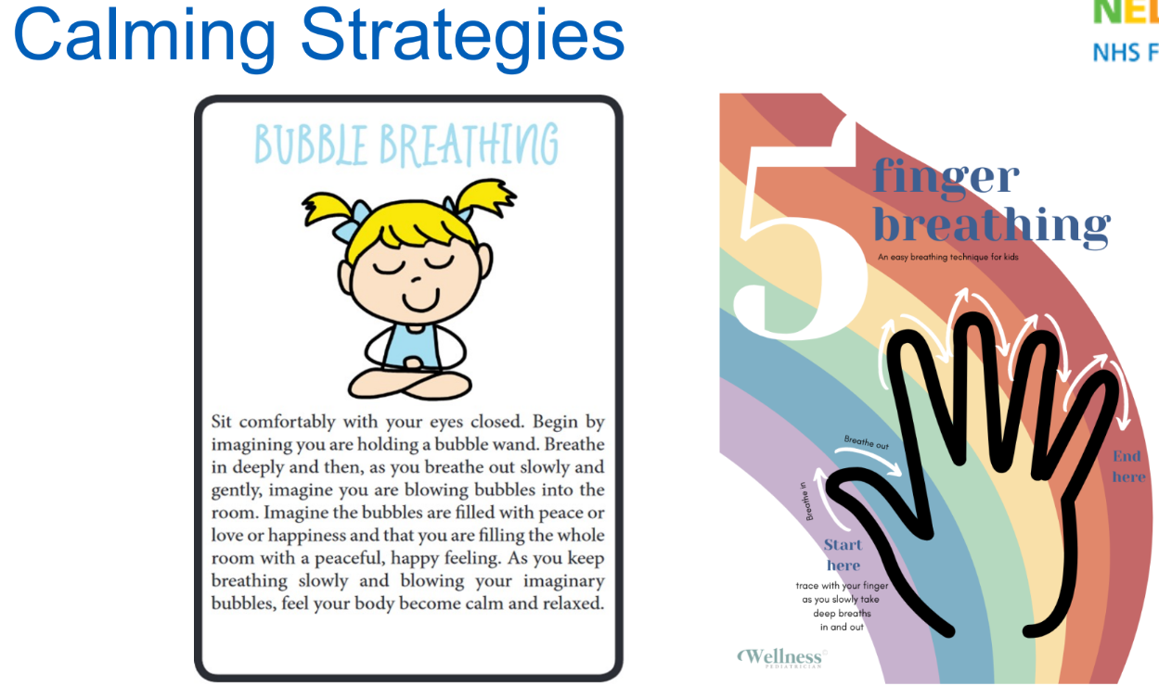

Slide 12
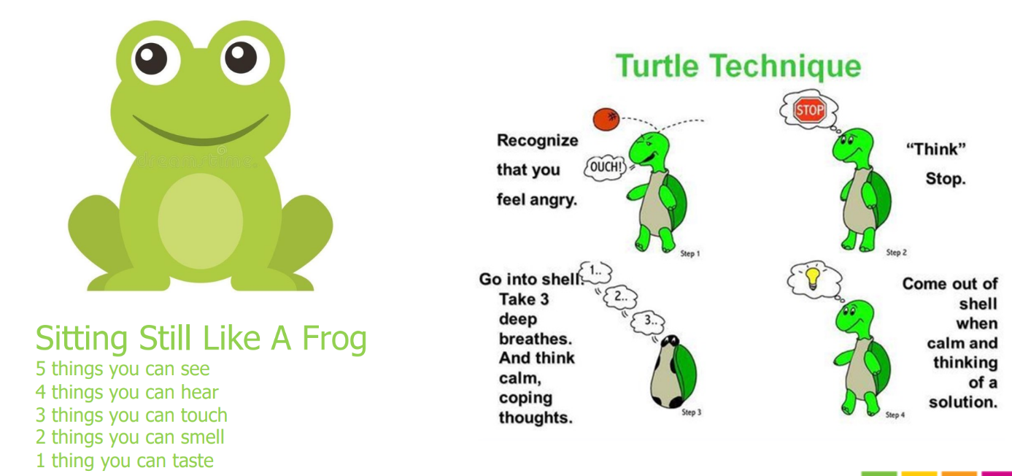

Slide 13
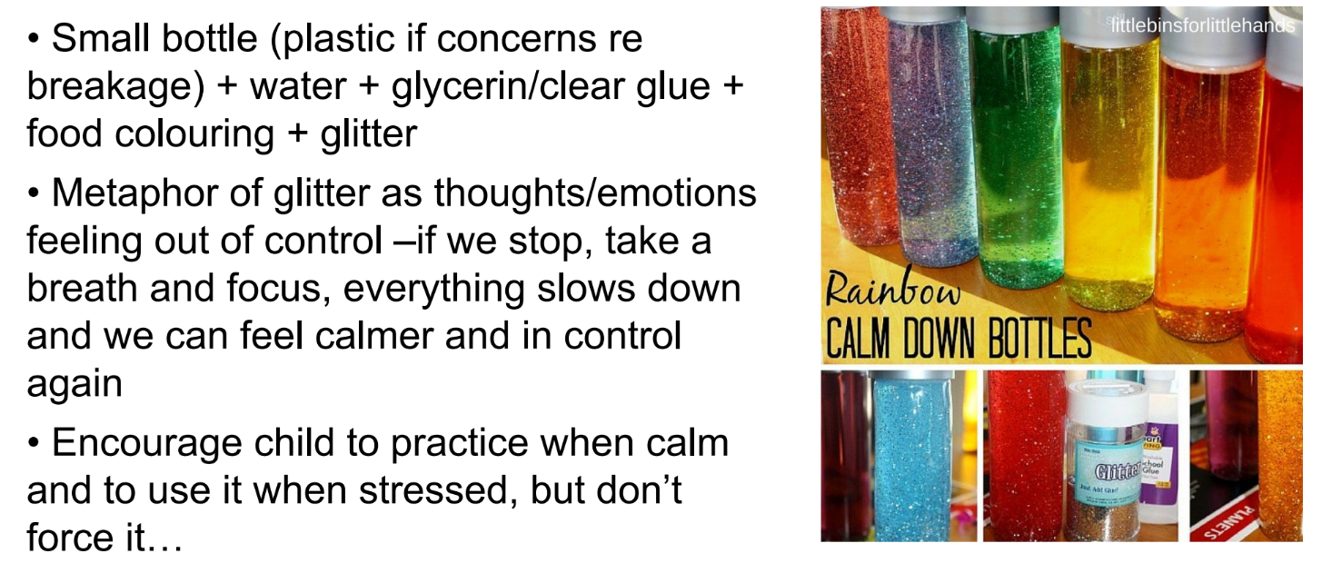
Glitter bottles

Slide 14
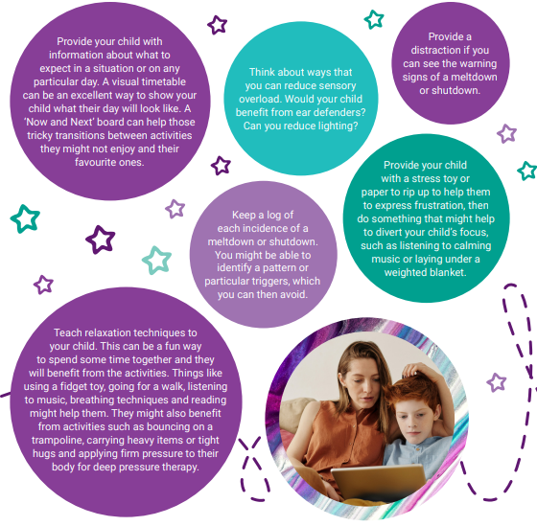
You will not be able to prevent your child from ever having a meltdown or a shutdown, but with some forward planning, you may be able to reduce their frequency. Try some of these:

Slide 15
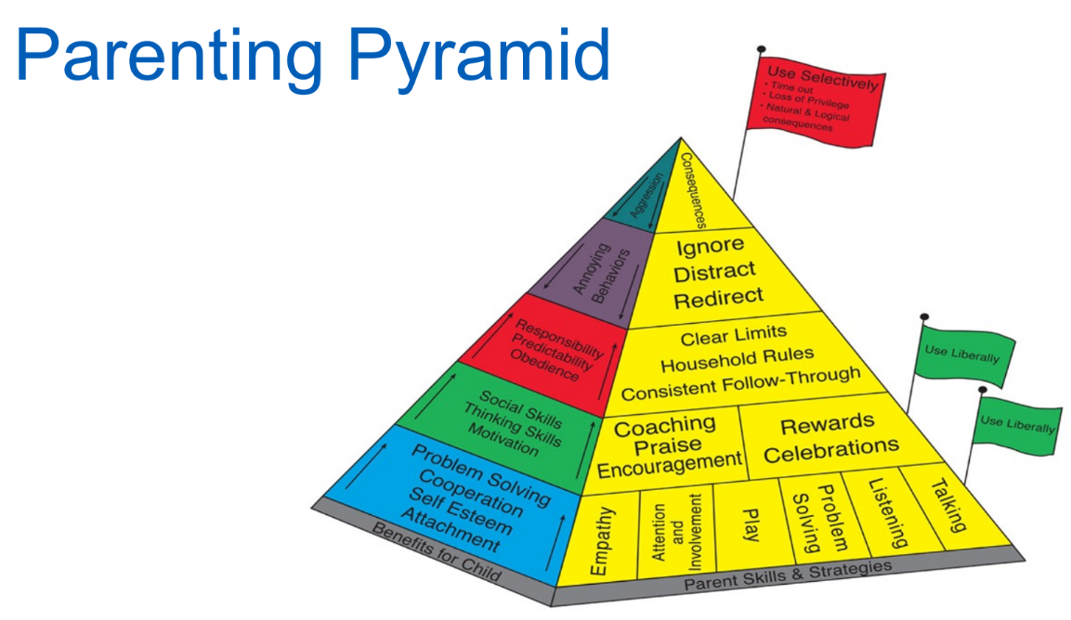
Strategies for responding to behaviours that Challenge

Slide 16
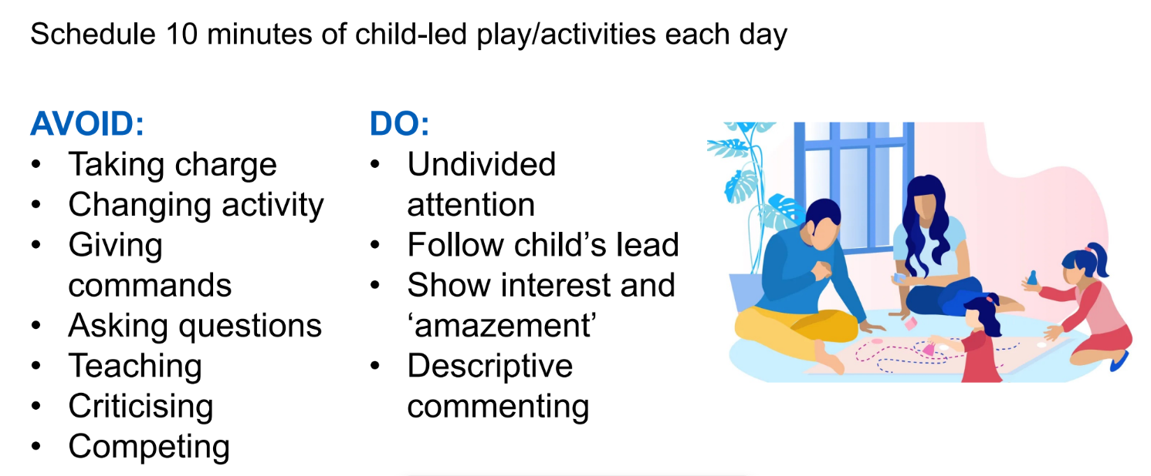
Special Times

Slide 17
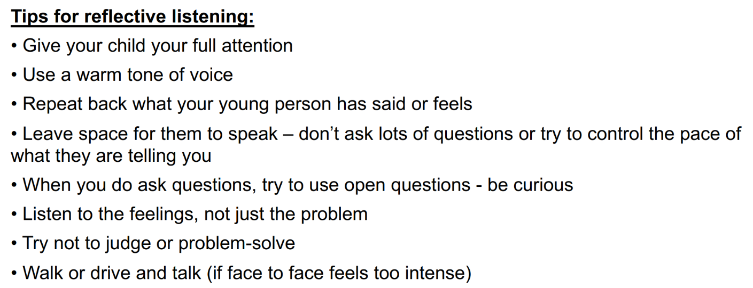
Listening

Slide 18
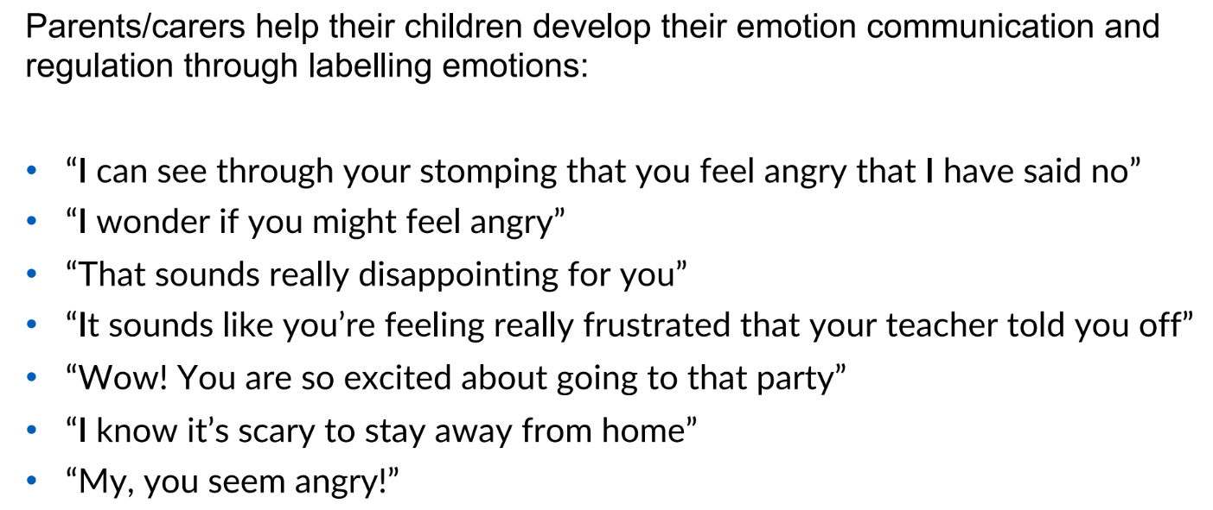
Talking

Slide 19

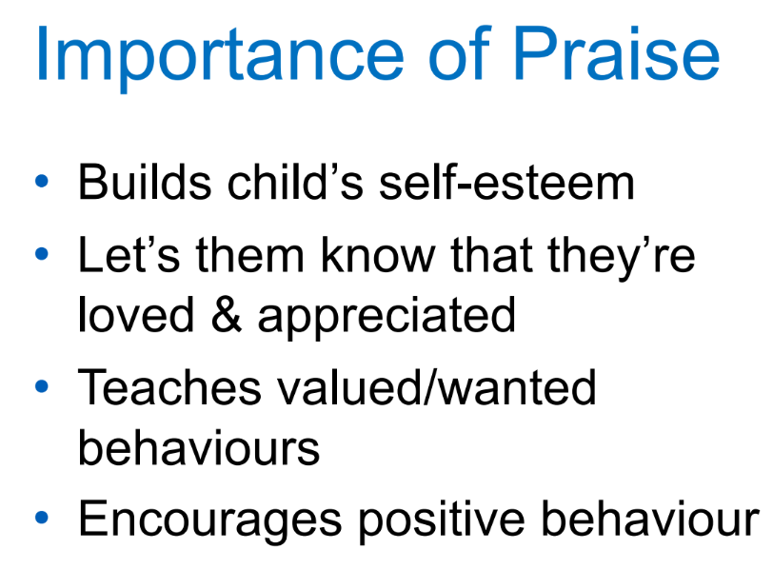

Slide 20
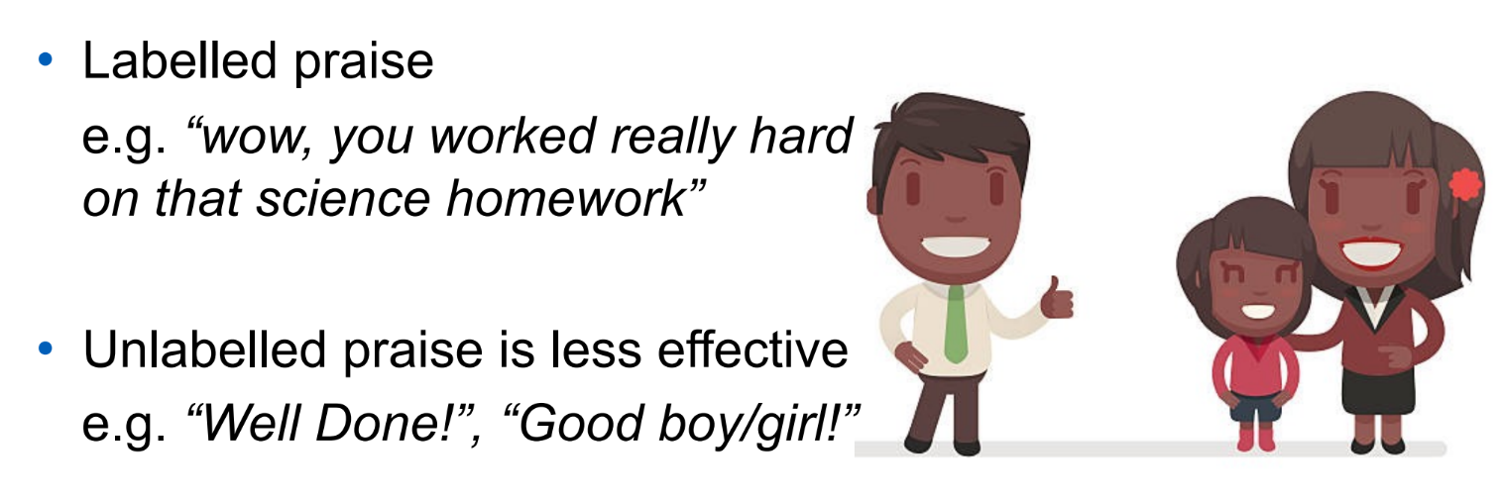
Giving effective praise

Slide 21
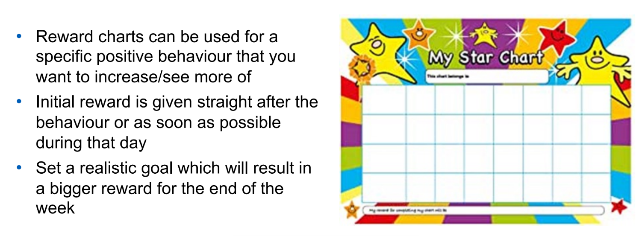
Reward charts

Slide 22
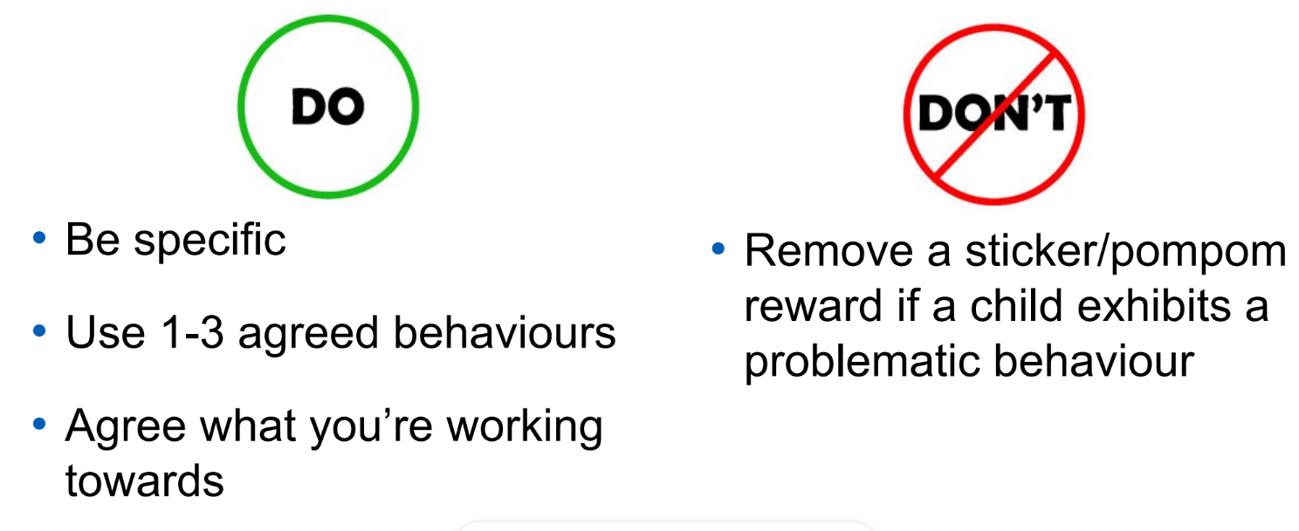
Rewards

Slide 23

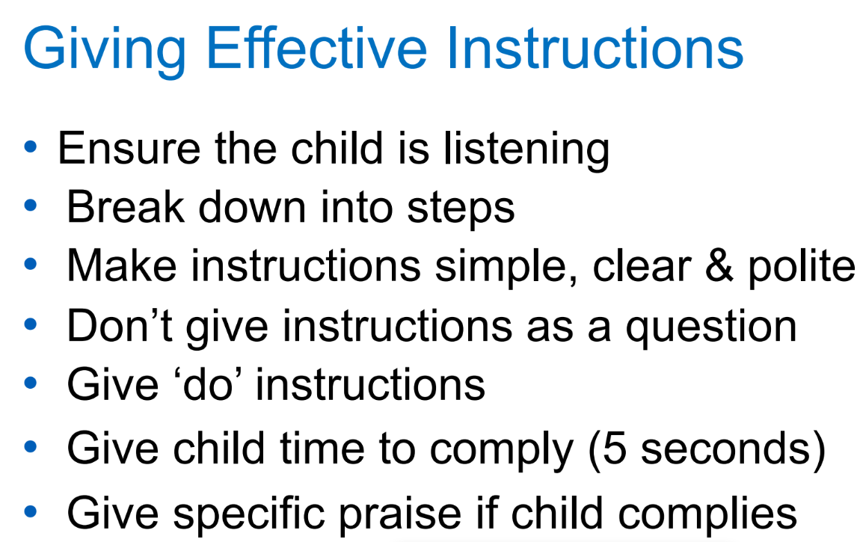

Slide 24
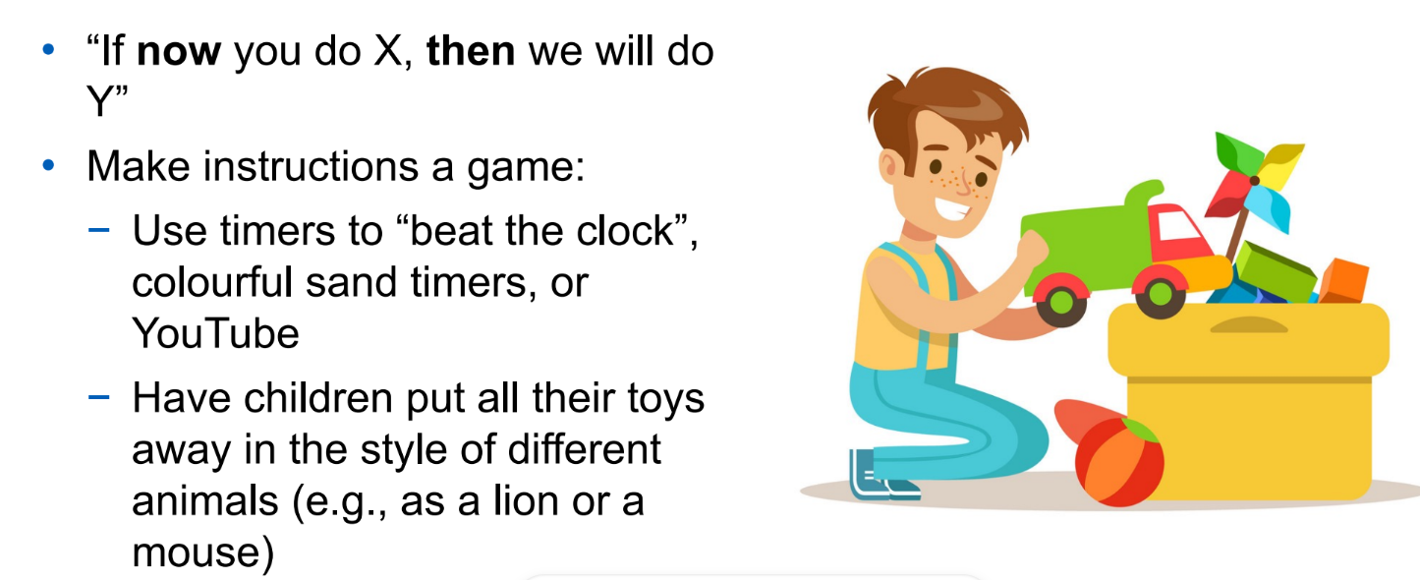
Managing demand avoidance

Slide 25
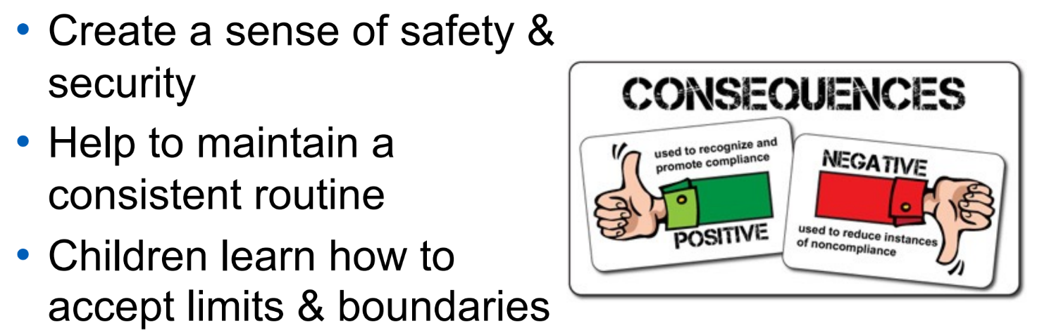
Consequences

Slide 26
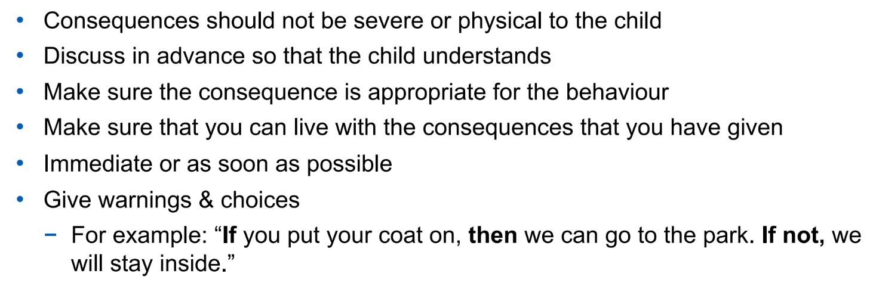
Guidance for logical consequences

Slide 27
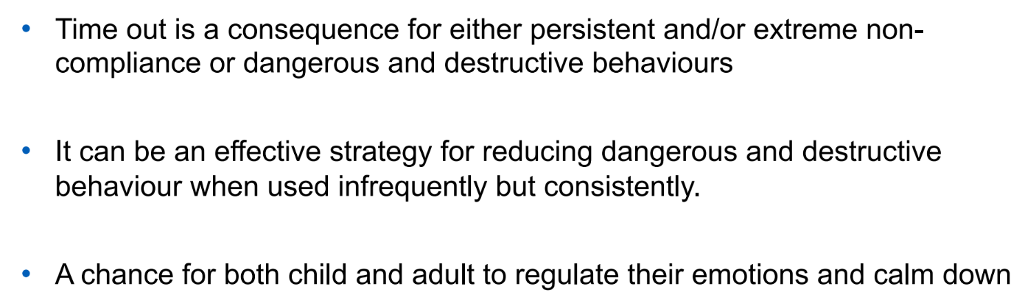
Timeout

Slide 28

Referrals for children with SEMH
Education Emotional Wellbeing Practitioners team - The Education Emotional Wellbeing Practitioners (EEWP) support Children and Young People (CYP), aged 0-25, in educational settings, that are currently experiencing mild to moderate Social Emotional Mental Health (SEMH)
Children’s Trauma Therapy Service -We aim to help children and families to understand their responses to these traumas, and make sense of the impact on their relationships, as they work towards recovery rather than being diagnosis focused. - https://www.family-action.org.uk/what-we-do/children-families/bradford/childrens-trauma-therapy-service/
Youth in mind - Youth in Mind is a partnership of six mental health and wellbeing services that provide one-to-one support and group support to children and young people aged 5 to 19 - https://www.mindinbradford.org.uk/support-for-you/youth-in-mind/get-support-for-someone-else/
SENDIASS - information, advice or support about matters relating to your child’s special educational needs - 01274 513300
CAMHS or ‘right to choose’ for ADHD and/or Autism. https://www.clinical-partners.co.uk/nhs-services/right-to-choose
Clinical partners - Talking therapy can help children by providing a safe space to express their feelings, learn coping strategies, change problematic behaviours, and ultimately make positive changes. - 0203 326 9160

Slide 29

Support

Slide 30

Reading for children

Slide 31
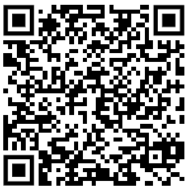
Thank you for coming!
Please complete this short online survey

