Slide 1

Parent coffee morning
Communication and Interaction

Slide 2
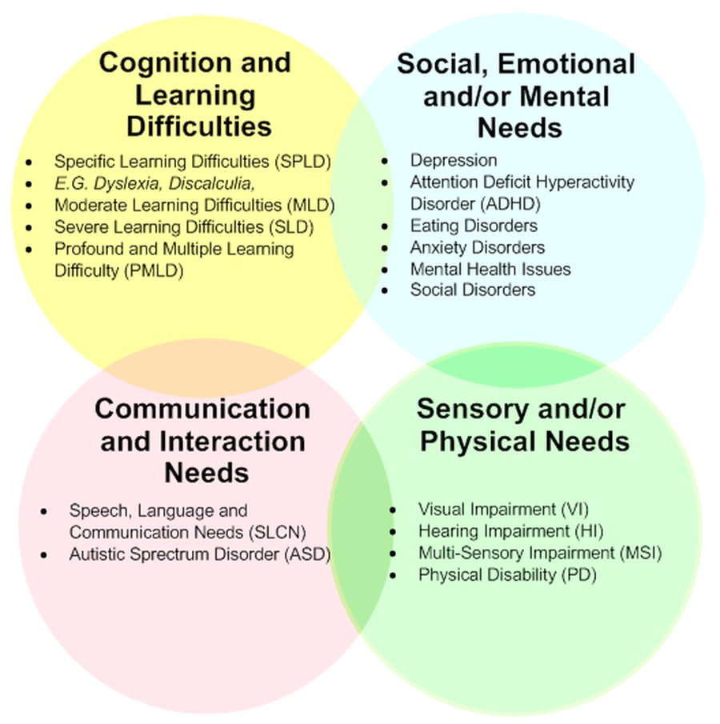
There are four areas to SEND

Slide 3

Today we are focussing on communication and interaction
Within the code of practice, communication and interaction is defined as follows:
Paragraph 6.29
‘Children and young people with speech, language and communication needs (SLCN) have difficulty in communicating with others. This may be because they have difficulty saying what they want to, understanding what is being said to them, or they do not understand or use social rules of communication. The profile for every child with SLCN is different and their needs may change over time. They may have difficulty with one, some or all of the different aspects of speech, language or social communication at different times of their lives.’

Slide 4
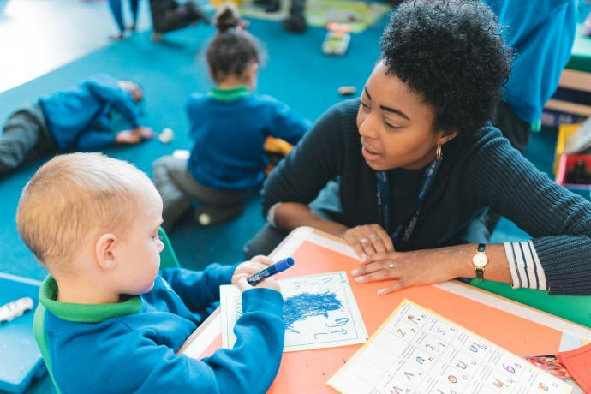
Children and young people with Autism are likely to have particular difficulties with social interaction.
They may also experience difficulties with language, communication and imagination, which can impact on how they relate to others.
Communication and interaction needs could include:
difficulties with producing or responding to expressive or receptive language
difficulties uttering speech sounds
difficulties understanding spoken and other communications from others
difficulties with understanding age-related social conventions of interaction, such as turn-taking during conversations or appropriate level of physical contact during play.

Slide 5
Difficulties children/young people may experience
Difficulty | Child/young person shows difficulty in: | Child/young person may show or have:
Receptive Language Difficulty | Listening Attention skills Understanding spoken language | Lack of interest in lessons Negative/disruptive behaviour
Expressive Language Difficulty | Conveying information in speech Writing Sign language or gestures | Not use correct grammar May produce very short phrases and sentences May have a small vocabulary May have limited eye contact Limited natural gestures Limited facial expressions
Pragmatic/Social Communication Difficulty | Use of social language and social rules of conversation Making and maintaining friendships Understanding of others feelings/emotions Inference Using non-verbal communication such as eye contact or facial expressions Sensory integration Staying on topic in conversations | Lack of interaction in lessons Lack of interest in peers
Speech Sound Difficulty | Co-ordination of the tongue, lips and palate Hearing | A family history of difficulties Delayed language development Additional diagnosed difficulties e.g. Developmental Verbal Dyspraxia, Down Syndrome etc.

Slide 6

Talking with your child

Slide 7
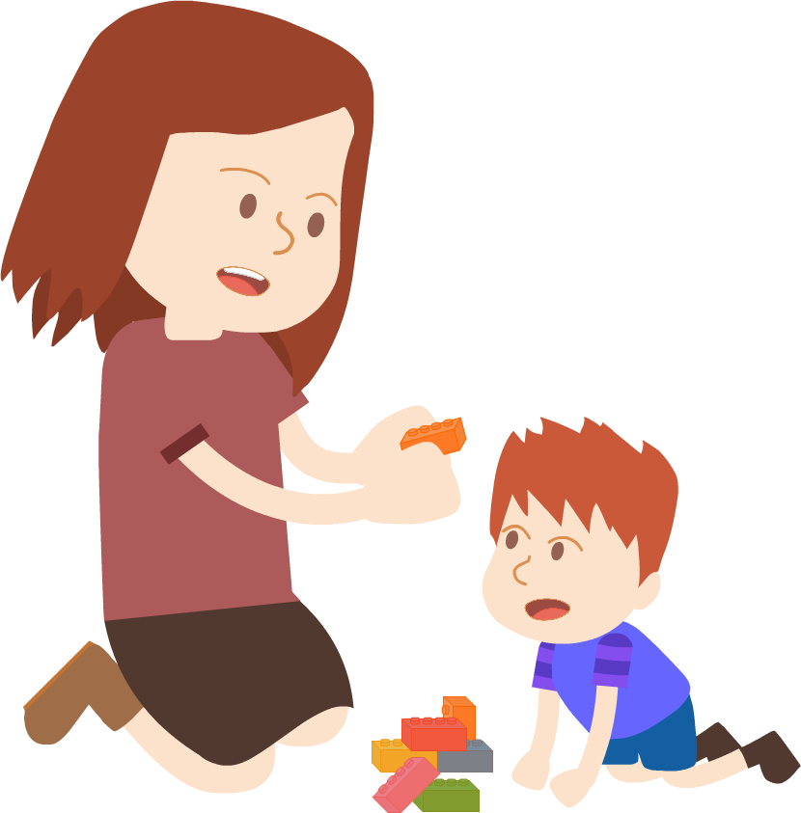
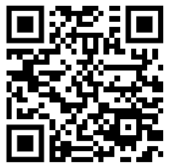
SLCN SURVIVAL GUIDES
https://speechandlanguage.info/parents/information

Slide 8
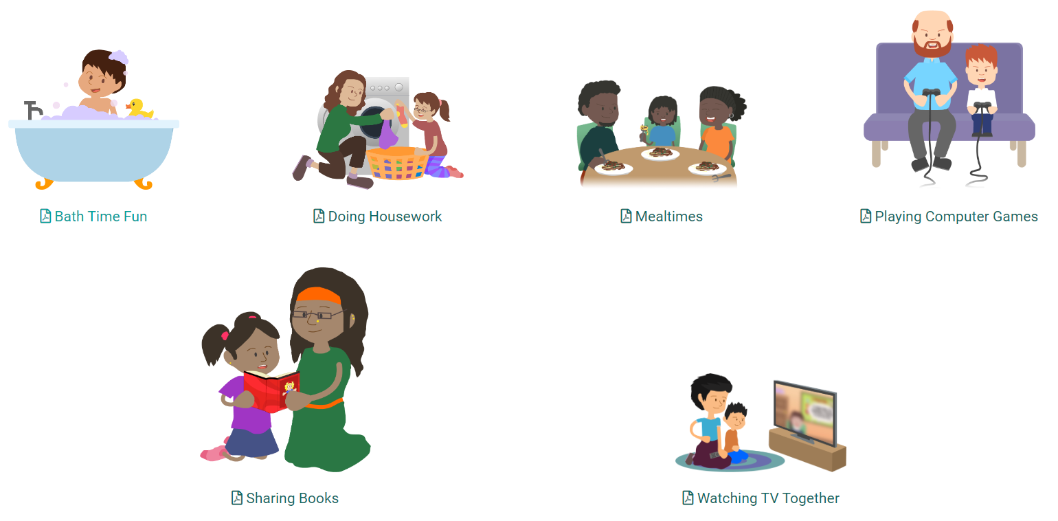
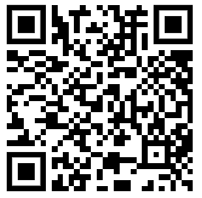
Lots of games and activities for you to use with your child at home to encourage their understanding and talking.
LANGUAGE ACTIVITIES
https://speechandlanguage.info/parents/activities/language

Slide 9
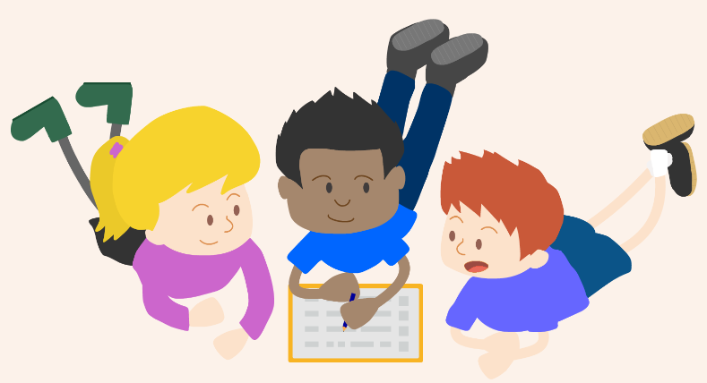
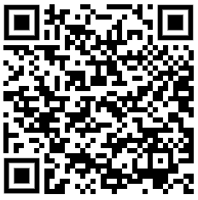
SPEECH ACTIVITIES
Some online games for your child to play. These games are graded listening tasks and early phonics tasks.
Some activities for you to complete with your child to encourage good sound discrimination to help their reading and talking.
https://speechandlanguage.info/parents/activities/parent-portal-speech-activities

Slide 10
Support for home – resources in the pack.
Talking mats
Memory games
Makaton
Now and next boards
Simple instructions
Teaching new vocabulary
Zones of regulation
Social stories.
Role play – social skills, imaginary play and turn taking ‘my turn your turn’.

Slide 11
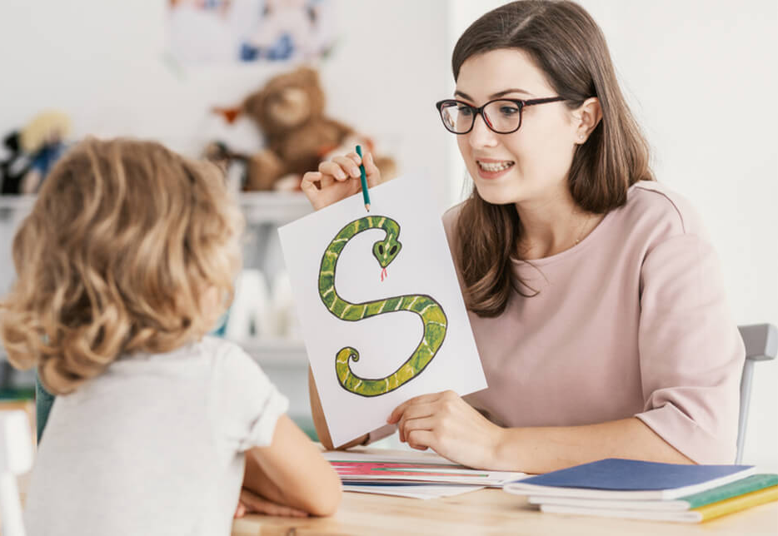
Speech and language therapy
Our specialist children’s team works with children in Bradford from ages 18 months to 18 years who have speech, language, and communication needs. We offer a range of services including assessment, advice, therapy, and training.

Slide 12
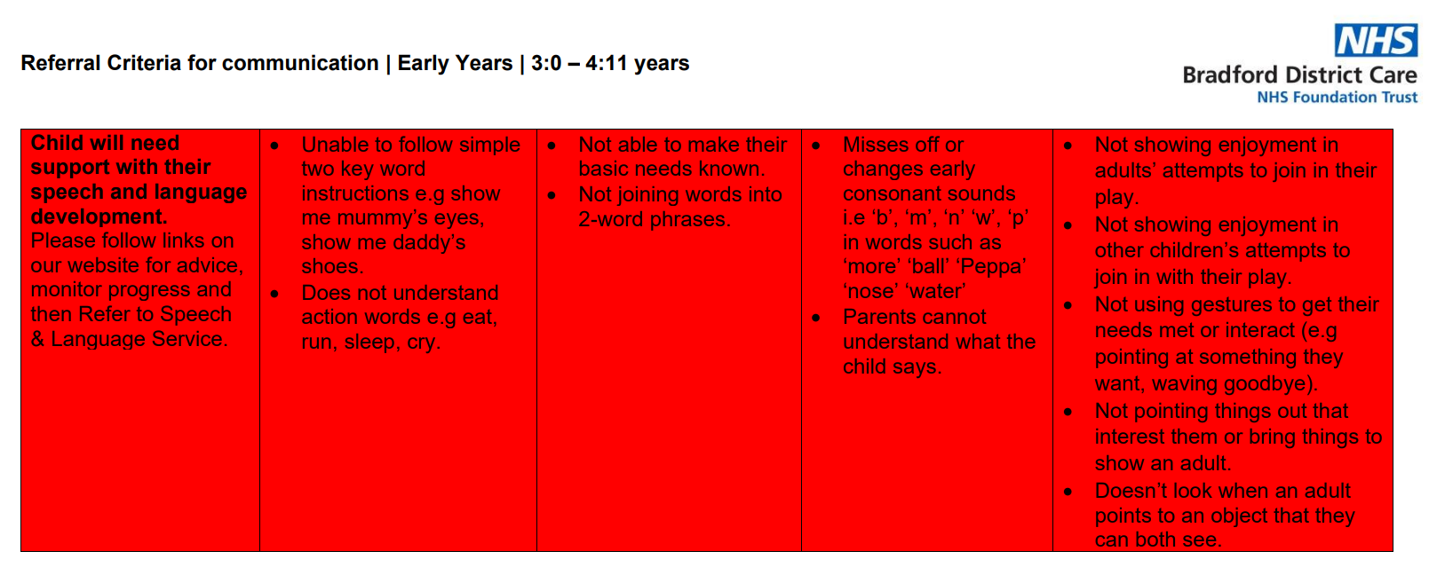

Slide 13
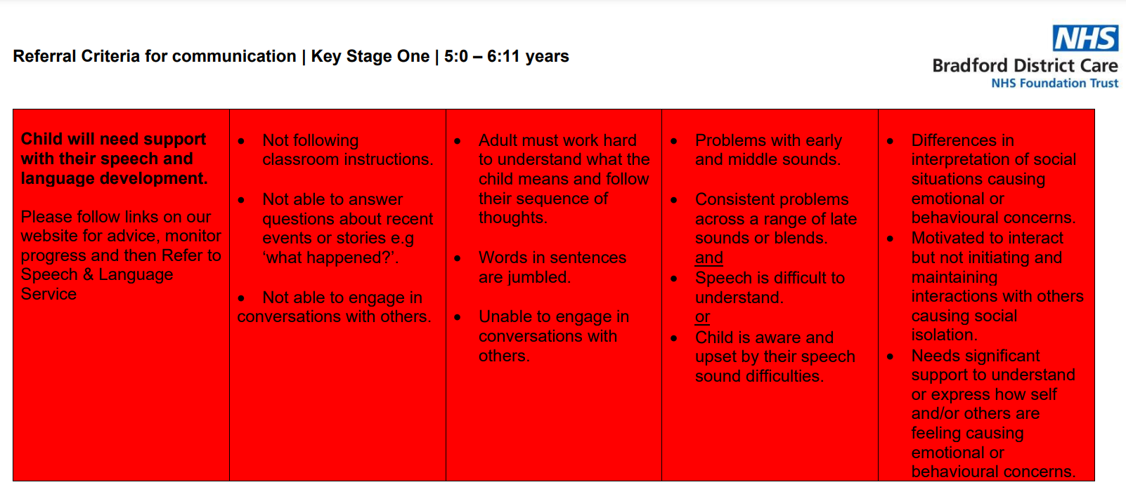

Slide 14

Any questions

Slide 15
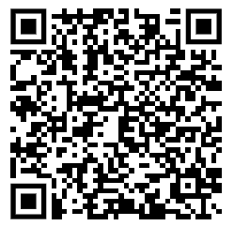
Please complete the feedback form

