Slide 1
New SENDCO
Miss Catherine Jordan
Class teacher in Year 2 and Phase lead for KS1
9 years teaching at Clayton St John contact details: sendco@claytonce.bdat-academies.org
Office number: 01274 815862

Slide 2
Purpose of these meetings:
To build a SEND community and facilitates communication with parents/carers.
A helpful space to identify and share any concerns around your child’s needs and to meet others sharing similar experiences.
To improve understanding of special educational needs and how to support your child at home.
To improve understanding of SEND processes and how support can be accessed in school as well as locally.
To support the planning and preparation for transition to new year groups or new school.
An opportunity to share your expertise with the school and influencing the school policies.

Slide 3
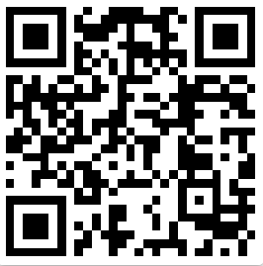
Local Offer
All local authorities must publish a Local Offer, setting out in one place information about provision they expect to be available across education, health and social care for children and young people in their area who have Special Educational Needs (SEN) or are disabled, including those who do not have EHCP. In setting out what they ‘expect to be available’, local authorities should include provision which they believe will actually be available.
https://localoffer.bradford.gov.uk/local-offer

Slide 4
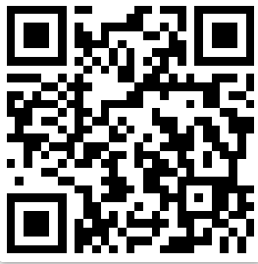
Clayton St John SEND page:
https://www.claytonce.co.uk/send/
You will find the SEND policy and SEND information report 2023.
Access to lots of resources to support different areas of need.

Slide 5
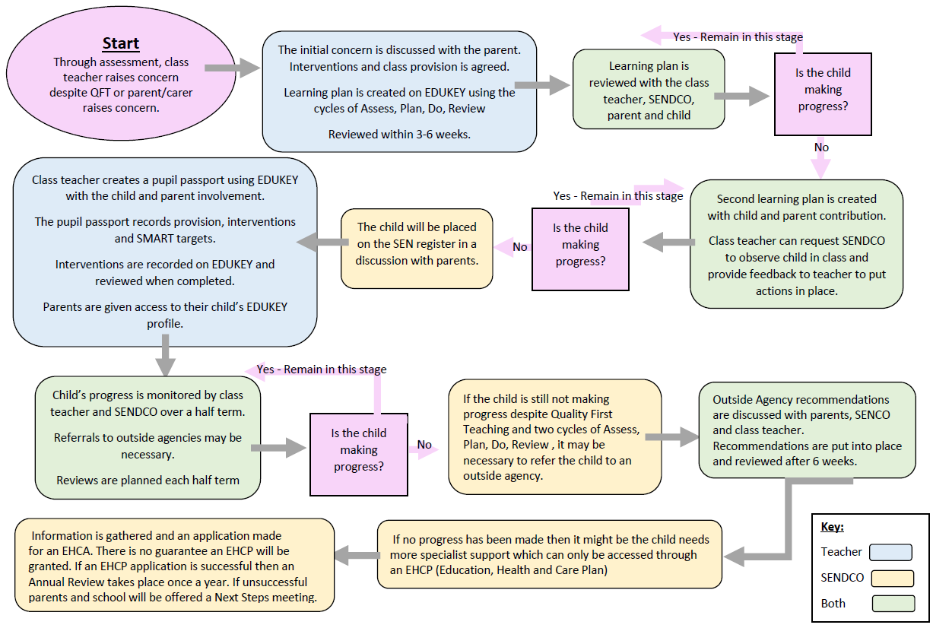
How SEND works a Clayton St John

Slide 6
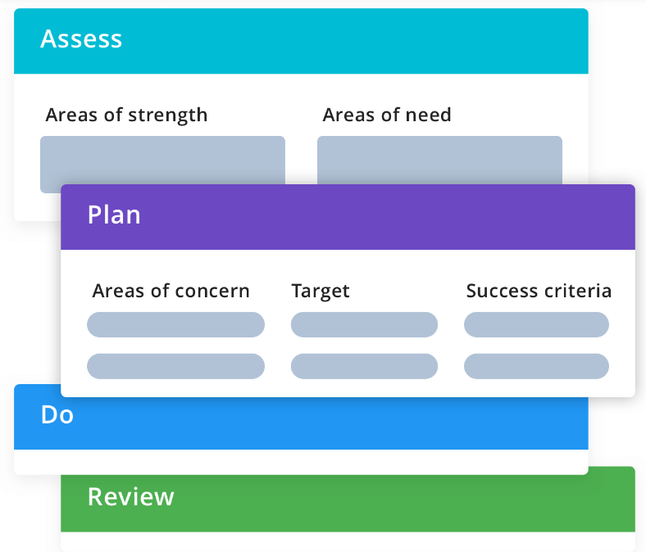
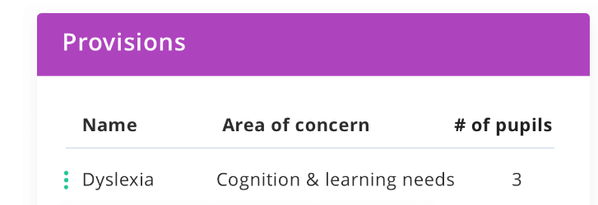
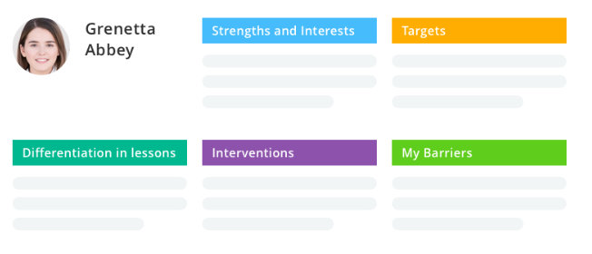
Provision Map

Slide 7
Support in school
Catherine Jordan – SENDCO
Katie Hughes – Welfare and Safeguarding officer.
Tanya Hall – Pastoral Lead
Adam Russell – Pastoral Lead

Slide 8
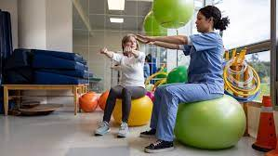






External Agency working in school
Occupational therapist
SCIL team
Educational psychologists
School nurse
School councillor
Speech and language therapist
WRAP support group

Slide 9
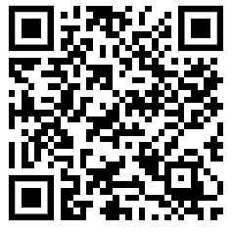
Apply for an EHCP
As parents/carers you are able to apply for an EHCP

Slide 10






Meet and greet

Slide 11
Zones of regulation

Slide 12




Strategies

Slide 13

Makaton friendly school

Slide 14
Schedule dates for each half term.
When is the best time to hold a half termly meeting?
What workshops/guess speakers/discussion topics would you like to focus on?

