Slide 1

PSHE and Citizenship
Living in the Wider World | Money Matters
PSHE and Citizenship | UKS2 | Living in the Wider World | Money Matters | Critical Consumers | Lesson 2

Slide 2
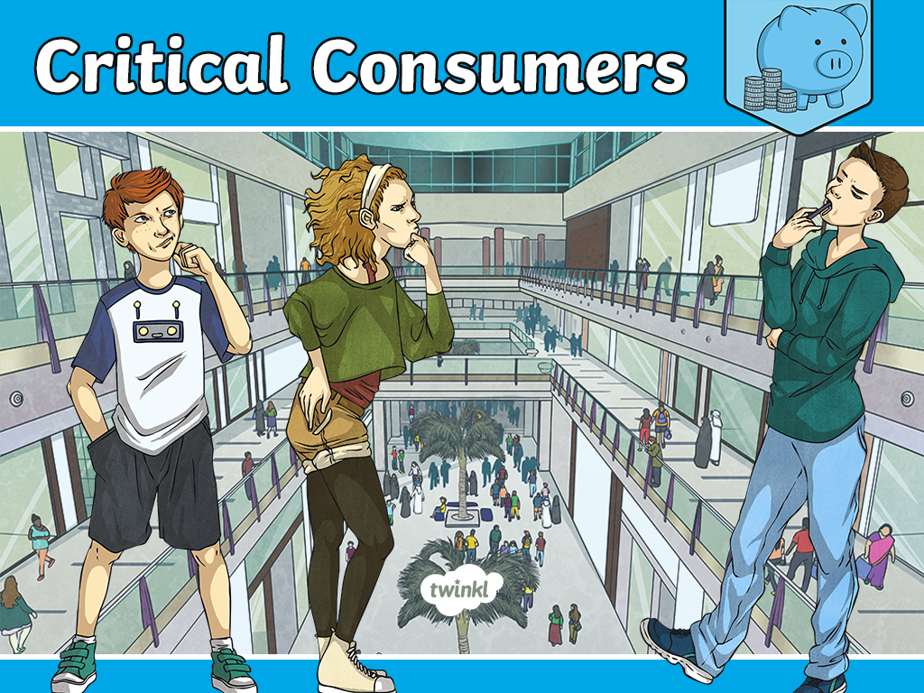

Slide 3
Aim
I understand how retailers try to influence our spending.
Success Criteria
I can explain some of the ways retailers try to influence our spending.
I can discuss how to be a ‘critical consumer’.
This resource is fully in line with the Learning Outcomes and Core Themes outlined in the PSHE Association’s Programme of Study.

Slide 4
The Big Questions

Slide 5
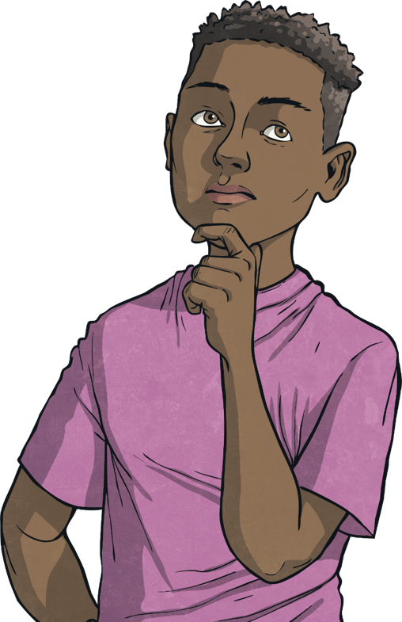

How do manufacturers and retailers try to influence the way we spend our money?
How can we be ‘critical consumers’?

Slide 6
Reconnecting

Slide 7


We Want Your Money!
What is this advert
trying to do?
How does it try to
influence you?
.
.
.
.
Why is it doing this?
.

Slide 8
Exploring

Slide 9



Deal or Better Deal?
Now let’s compare two adverts for similar products:
These two advertisements are for a similar product. Talk to your partner about the following:
Which would you choose to spend your money on?
Why?
How does the advertisement influence your spending?
Remember that when we choose a product, other similar products are available and may even be better! Adverts try to influence our spending by convincing us to have their product, remember to think about why they are doing this.
.
.
.
.
.
.
.
.

Slide 10
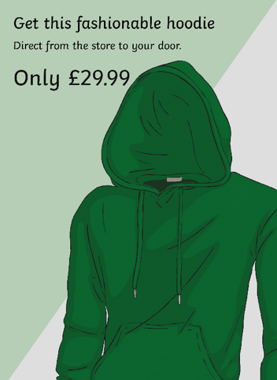
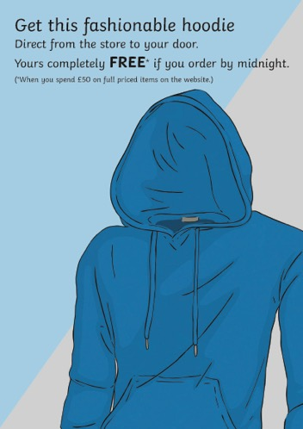
Deal or Better Deal?
We have looked at the way advertising can influence our spending but can offers
influence our spending too? Now let’s compare two more adverts for similar products:
Manufacturers and retailers try to influence our spending in many ways. There may even be hidden costs with some products. It is important to see those hidden costs and work out how much the products will actually cost you. To be ‘critical consumers’ we must be aware of this so we can make sure we get the best deal available.
These two advertisements are for a similar product.
Which would you choose to spend your money on?
Why?
How do the offers try to influence your spending?

Slide 11

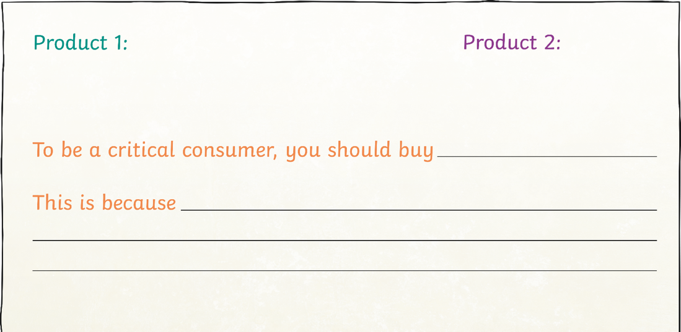
Which Deal Most Appeals?
We are now going to compare advertisements.
You will be given a pack of adverts. Within the pack, there are two adverts which are for a similar product. Match the two similar advertisements and work as a group to compare them as a critical consumer. Remember to look beyond the advertising techniques and look at the actual cost of the product. Record which you think is actually a better deal.

Slide 12
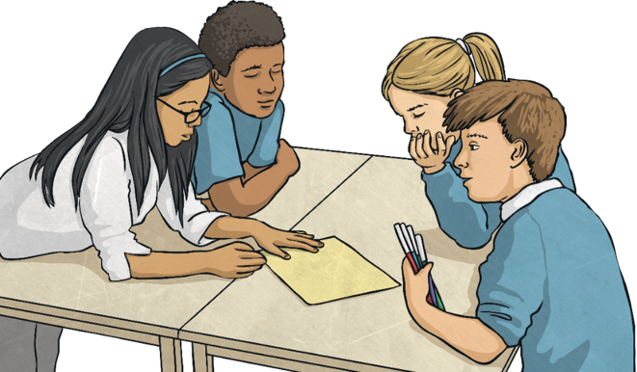
Which Deal Most Appeals?
Now, look at the learning of other groups and consider the following:
Did they sort the adverts in the same way as you?
Were their reasons for sorting the adverts similar?

Slide 13
Consolidating
Reflecting

Slide 14
Consolidating

Slide 15

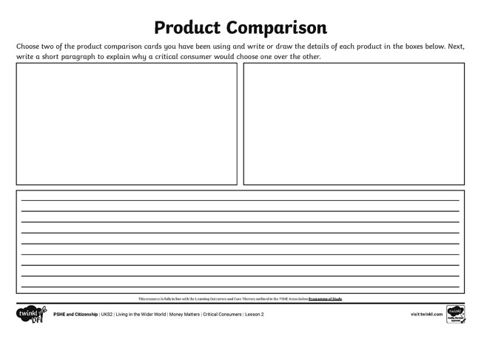
Product Comparison
Using your knowledge from the sorting activity, choose one of the pairs
of products and record your comparison on the Product Comparison Activity Sheet.
Try to include as much detail as possible about:
the actual cost of the product
the benefits of this product over its competitor
any ongoing payment that would be needed
Start your paragraph with:
To be a critical consumer, we need to understand…
Word Bank
money
manufacturer
retailer
advertise
influence
critical consumer

Slide 16
Reflecting

Slide 17
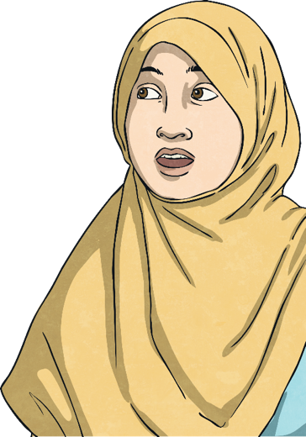
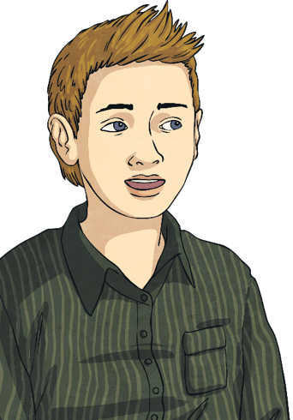
How to Be a Critical Consumer
Working with your partner, we are now going to compile a list of all the things you think are important when trying to be a critical consumer.
Take it in turns to write a sticky note of something to consider when buying a product.
Look at the asking price.
Look if it is being sold as part of a set.
Come and share your sticky notes by adding them to the board.

Slide 18
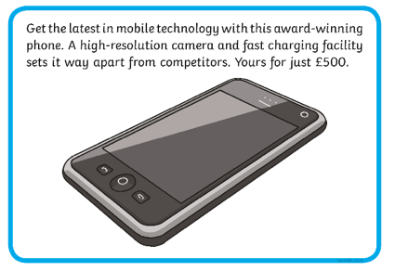
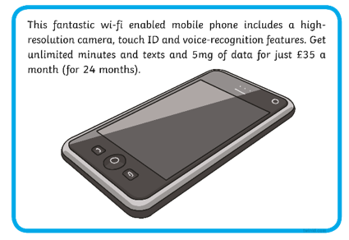
How to Be a Critical Consumer
Can you think of any reason why people might choose a deal that actually ends up being more expensive?
Let’s compare these two:
Thinking about what you know about wages and income, as well as what we have learnt about financial risk, can you suggest any reasons why people might want to choose a product that is actually more expensive?
A smaller monthly cost may suit people’s budget, rather than having one big expensive item to buy. This is a personal choice but it is always important to consider the full cost when comparing products.

Slide 19
The Big Questions

Slide 20
How do manufacturers and retailers try to influence the way we spend our money?
How can we be ‘critical consumers’?
How will you use what you have learnt in your daily life?

Slide 21
Aim
I understand how retailers try to influence our spending.
Success Criteria
I can explain some of the ways retailers try to influence our spending.
I can discuss how to be a ‘critical consumer’.
This resource is fully in line with the Learning Outcomes and Core Themes outlined in the PSHE Association’s Programme of Study.

