Slide 1

PSHE and Citizenship
Living in the Wider World | Money Matters
PSHE and Citizenship | UKS2 | Living in the Wider World | Money Matters | Borrowing and Saving | Lesson 5

Slide 2
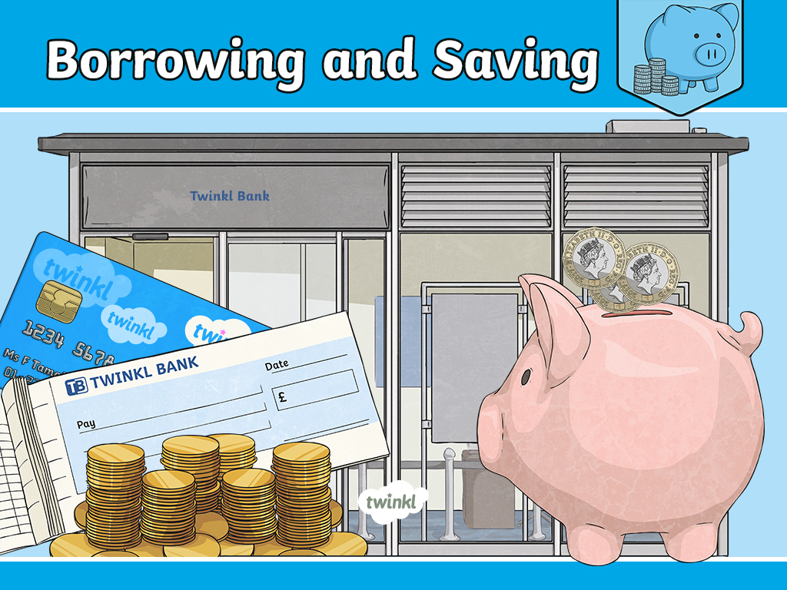

Slide 3
Aim
I can discuss reasons and consequences of borrowing money.
Success Criteria
I can discuss choices people have about how to use money.
I can explain why people borrow money.
I can discuss some consequences of borrowing money.
This resource is fully in line with the Learning Outcomes and Core Themes outlined in the PSHE Association’s Programme of Study.

Slide 4
The Big Questions

Slide 5

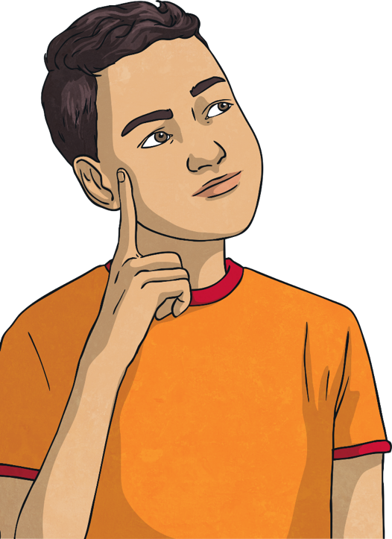
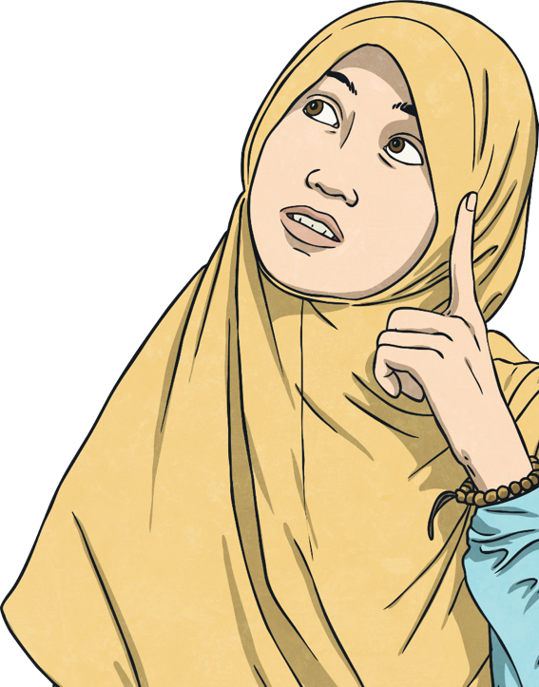
What are the risks and consequences of borrowing money?
What effect can this have on our emotional wellbeing?

Slide 6
Reconnecting

Slide 7

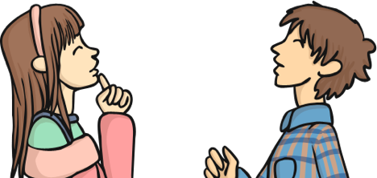
Explain it!
In this lesson, you will need to use the key words shown at the bottom of the slide.
Working in partners, one of you will need to sit so you can see the board (this person is the ‘explainer’), and one of you cannot (this person is the ‘guesser’). You might be able to sit back to back.
The ‘explainer’ needs to choose a word and describe it, without saying the actual word so that the ‘guesser’ can identify it.
Ready?
interest
saving
debt
borrowing
Can you now work together to link these four words in a sentence?

Slide 8
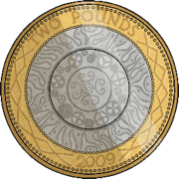
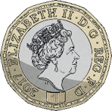
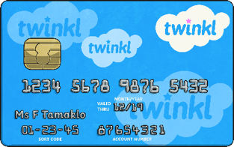
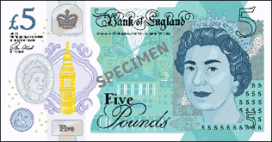

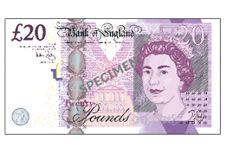
Explain it!
Now, let’s share some definitions of the words we will be using today:
Borrowing
When something is borrowed it needs to be returned. If people do not have enough money for what they need to buy, they may need to borrow money. Money can be borrowed by taking out a loan. This is an amount of money that is borrowed and needs to be repaid. When the money is repaid, interest is charged at an agreed rate.
Interest
A fee charged by the lender when money is borrowed.
A deposit made by a savings institution when money is saved.
Savings
People may choose to put an amount of money aside regularly, or when they can afford it, to save up for expensive or unexpected costs.
Debt
An amount of money that has been borrowed and now needs to
be repaid.

Slide 9
Exploring

Slide 10

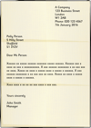
















Why Borrow Money?
Let’s think about why people might need to borrow money. Look carefully at this picture. What do you think it shows? Talk to your partner and be ready to share your ideas.
There are lots of regular costs associated with running a household. These could include: food, heating, water and power, along with phone and TV subscriptions. People may feel they need to borrow money if these costs cannot be met, or if they have a particularly expensive or unexpected cost to meet. Let’s now think about what these may be.

Slide 11

Why Borrow Money?
There are many reasons people borrow money, however some common reasons include:
University fees
Mia wants to go to university. She knows the cost of going to university can be very high. She has taken out a student loan to cover her living costs and the cost of tuition fees. She will pay the loan back when she gets a job and earns over a certain amount. The repayments are taken straight from her wages.

Slide 12
Why Borrow Money?
Sometimes people need to borrow money for an unexpected cost.
This may be because something has gone wrong or because they
have taken a risk with money.
Unexpected costs
Theo’s car has broken down and the mechanic has said it will be too expensive to
repair. He has seen an offer for a brand-new car that he will pay for over a number of
years. He will have to pay £500 a month which he can hardly afford but he needs a
car to get to work so doesn’t feel like he has
a choice.

Slide 13



Why Borrow Money?
Mortgage
Dapo and Ash want to buy a house so
they need to take out a mortgage. This is a
loan from a bank or building society that
covers any cost of the house that the buyer
cannot meet. To take out the mortgage
Dapo and Ash will need to prove their
earnings to show they can cover
the cost of repayments. These repayments will be made over many years and
will incur an agreed amount of
interest that may change over time.
By looking carefully at the mortgage and loan offers available in these situations, loans can be used with reasonable repayment rates and agreed interest rates.

Slide 14
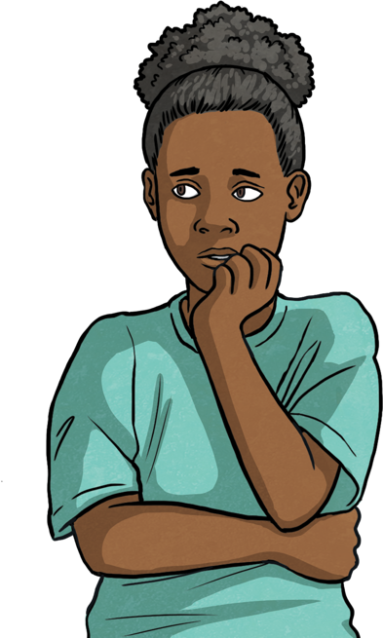
Why Borrow Money?
Sometimes people need to borrow money if they have taken risks
such as gambling.
Risks with money
Felicity has started hanging around with a new group of friends. They have started
playing games and gambling with money. She has tried to join in but has lost some
money. She now can’t afford what she needs for the month so will have to take out a loan that she didn’t plan to.

Slide 15
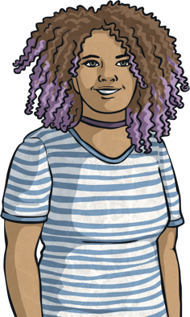
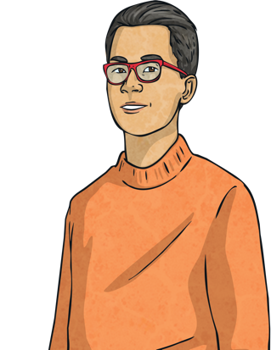
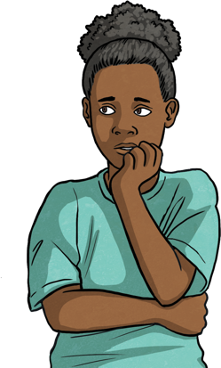

Emotional Effects
We have looked at some examples of reasons people might borrow money.
Some of these may have positive effects on emotions and wellbeing and some may lead to uncomfortable feelings. Talk to your partner and discuss the possible effects of the different examples on emotions and wellbeing.
Who might feel good about the outcome of borrowing money?
Who might feel worried or stressed?

Slide 16
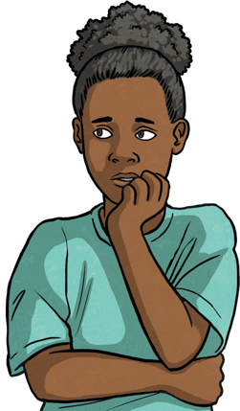
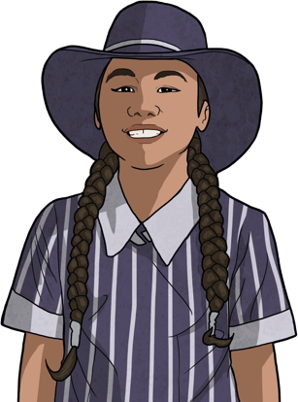
Emotional Effects
There are many reasons why people might need to borrow money. There are
also many effects this can have on emotions as our financial wellbeing can have an impact on our emotional wellbeing as well.
If someone didn’t plan to borrow money, they
may need to take out a short-term
loan which can carry large interest rates.
This may mean people have to act before
being able to really think about the options
and it may become clear that the loan
repayments are unaffordable. This can
cause worry and stress.
If the money is borrowed to enable a plan and achieve a
goal, like going to university or buying a house, as long
as they can keep up the repayments it is likely that this
would make someone feel good. They had a plan,
researched and acted on it and now probably feel a
sense of achievement.
By saving any spare money when we can and thinking about the future, we can plan how best to use our money and look carefully at the options available to us.

Slide 17
Emotional Effects
Now let’s consider some repayment options:
You take out this credit card and use it to pay £400 for a holiday. You manage to save £400 the following month so pay it off on time. What do you get charged?
Loans of Money
Credit Card
You take out this credit card and use it to pay £400 for a holiday. You do not have £400 available to pay off the balance the following month so you start to accrue interest. How much interest would you be charged over a year?
Interest Rate = 20% per year.
You are charged nothing above £400 because the balance was paid on time.
£1000 credit limit
You would be charged £80 interest
£400 ÷ 100 = £4
20 × £4 = £80
Total repayment after 1 year = £480
0% interest charged on balances that are paid on time.

Slide 18
Emotional Effects
You take out a short-term loan to pay for a new car. You take out £3000 and pay it back over 6 months. How much do you repay?
Loans of Money
Short-Term
Loan
You take out a short term loan to pay for a new car. You take out £3000. After a year you are unable to repay any of it. How much would you now owe?
You are charged £4500
£3000 × 3 = £9000 would be the cost of interest over a year
£9000 ÷ 2 = £4500 as you repaid it in 6 months we divide the yearly interest cost by 2. Your total repayment would be £7500. £3000 + £4500 interest = £7500.
Interest Rate = 300% per year.
You now owe £9000
£3000 × 3 = £9000 would be the cost over a year
If this remains unpaid the cost will continue to increase.
£5000 credit limit
Loans agreed in minutes apply now!
Short-term loans and situations where money is needed very quickly can often have larger interest rates which lead to much larger repayments and can therefore cause stress and worry. By trying to save money where we can, we can help to avoid unexpected borrowing.

Slide 19

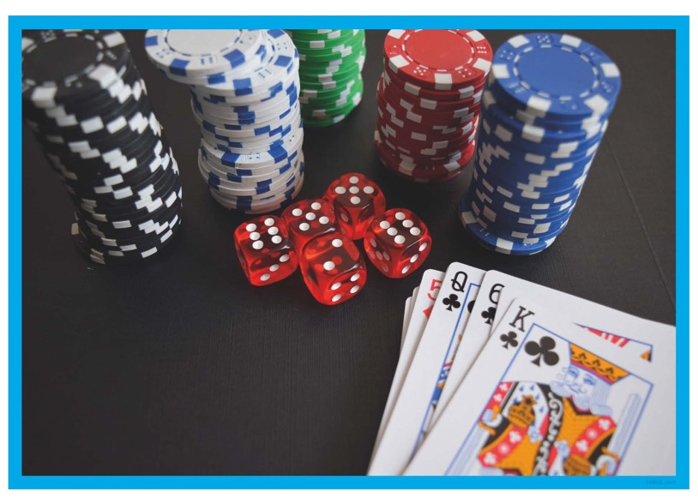
Emotional Effects
Working with your partner, you will now be given a pack of Borrowing Choices – You Decide! Picture Cards. You need to sort them into two piles those that could be planned and those that create an unexpected cost.
Working in your pairs, choose one of the pictures you have sorted and create a story around it. Try to think about:
why the person needed to borrow money.
whether this cost was planned or unexpected.
what effect the borrowing has had on their wellbeing.
Now let’s see how other pairs sorted their cards.

Slide 20
Consolidating
Reflecting

Slide 21
Consolidating

Slide 22

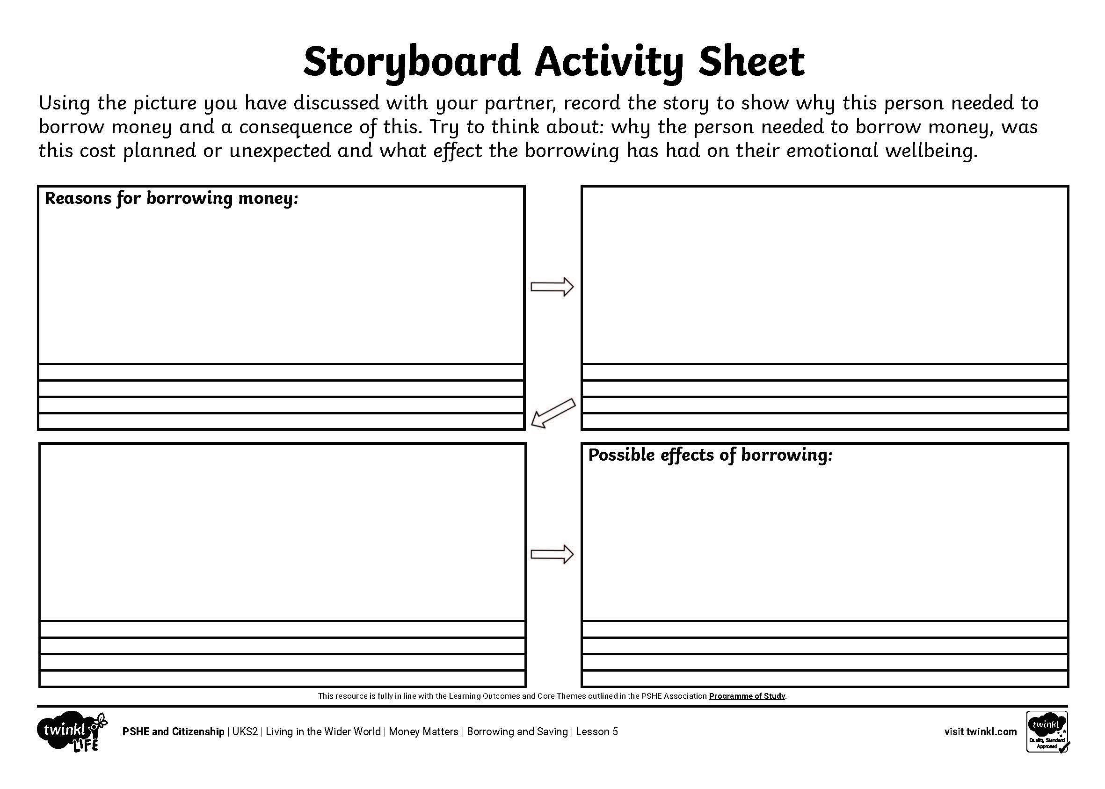
Financial Choices,
Emotional Effects
Using the story you have just discussed with your partner, create your own storyboard to show the reasons for borrowing money and the possible consequences of this.
consequences
risk
money
lend
loan
interest
borrow
Try to think about:
● why the person needed to borrow money.
● whether this cost was planned or unexpected.
● what effect the borrowing has had on their emotional wellbeing.

Slide 23
Reflecting

Slide 24


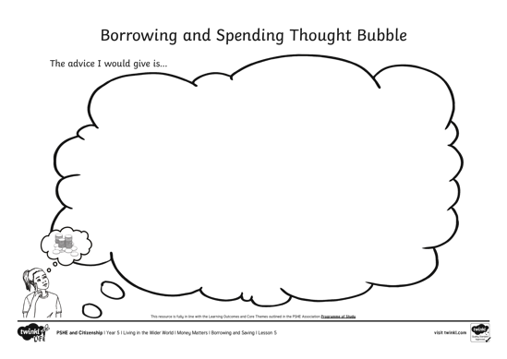
How Can We Avoid Debt?
Now, let’s think again about the Big Questions.
How have your opinions changed on borrowing money with what we have learned this lesson?
In small groups, discuss what advice you would give to people about how to manage their money.
Record your group’s ideas on your thought bubble.
The advice I would give is…

Slide 25
The Big Questions

Slide 26
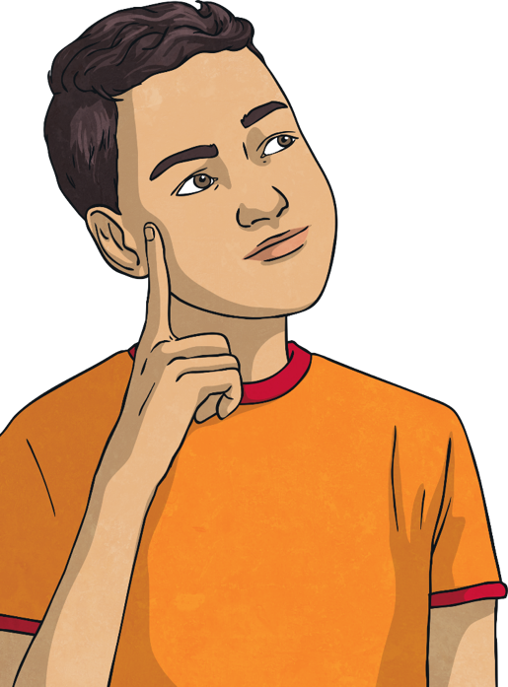
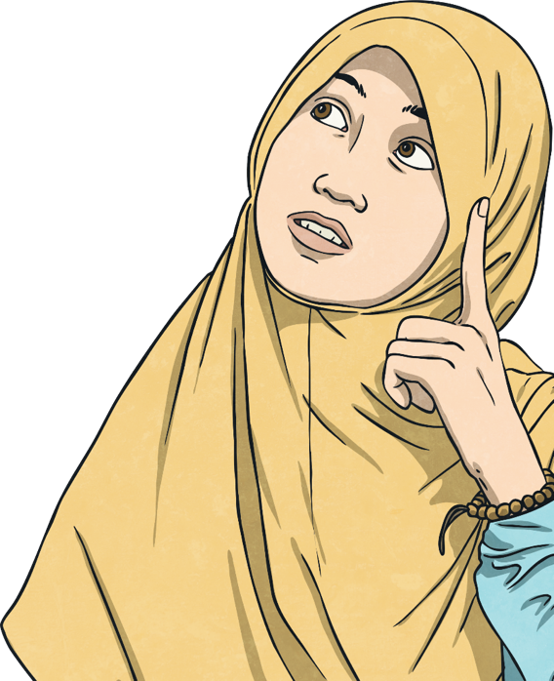
What are the risks and consequences of borrowing money?
What effect can this have on our
emotional wellbeing?

Slide 27
Aim
I can discuss reasons and consequences of borrowing money.
Success Criteria
I can discuss choices people have about how to use money
I can explain why people borrow money.
I can discuss some consequences of borrowing money.
This resource is fully in line with the Learning Outcomes and Core Themes outlined in the PSHE Association’s Programme of Study.

