Slide 1





£1,219.40
£2,138.95
Hang on, I’ll just work it out…
How?! I haven’t written the numbers yet!
I have £3,800 in my bank. Can I afford to buy the TV and laptop?
STOP! I already know he can afford it.
2
1
3
8
.
9
5
1
+

Slide 2
£1,219.40
£2,138.95
I rounded £2,138.95 to £2,100
I rounded £1,219.40 to £1,200
£2,100 plus £1,200 is £3,300
so Ron has enough money

Slide 3
An estimate – a sensible but
not exact answer.

Slide 4

7,116 – 3,655 =
7,000
7,116 rounded to the nearest 1,000 is
4,000
3,655 rounded to the nearest 1,000 is
7,000 – 4,000 =
3,000
7,100
7,116 rounded to the nearest 100 is
3,700
3,655 rounded to the nearest 100 is
7,100 – 3,700 =
3,400
Have a think
Which is the more accurate estimate?

Slide 5
Re group!

Slide 6

 | Shop A | Shop B | Shop C
Morning | £4,000 | £6,231 | £2,002
Afternoon | £11,613 | £9,199 | £14,508
Estimate which shop made the most money.
Shop C
Shop A: 4,000 + 12,000 =
That’s already rounded to the nearest 1,000!
£ 16,000
Shop B: 6,000 + 9,000 =
£ 15,000
Shop C: 2,000 + 15,000 =
£ 17,000
Have a think
Did shop B make more or less than £ 15,000?
More

Slide 7
BACK TO NOTEBOOK

Slide 8
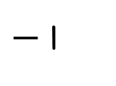
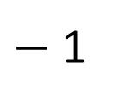
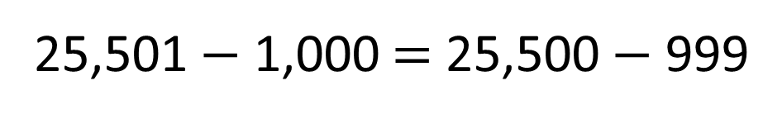
True or false?
6
3
9
83,155 + 542 > 524 + 83,155
True
Have a think
$−$ 1
3
$−$ 1
5
8
What’s stayed the same?
What’s changed?
constant difference
25,501 $−$ 1,000 = 25,500 $−$ 999
True
Have a think
1 less
1 less
What’s stayed the same?
What’s changed?

Slide 9
BACK TO NOTEBOOK

