Slide 1


Slide 2
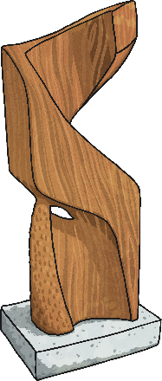
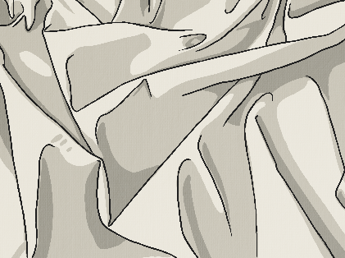
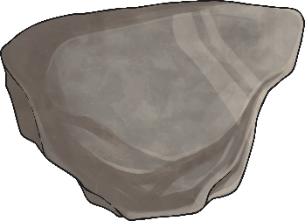
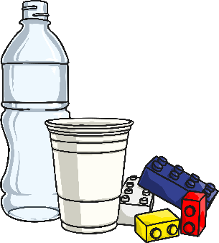

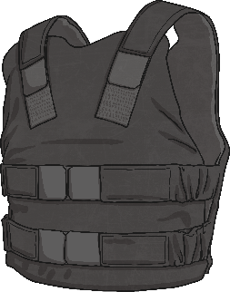
Describing Materials
Any substance that is used to
make something is a material.
Natural materials such as stone, wood and cotton are used or worked with in the way they are found in nature.
Synthetic or human-made materials are made from natural materials, but are altered with the help of heat or chemicals. Some examples include plastics,
polyester and Kevlar.
Natural
Human-made

Slide 3
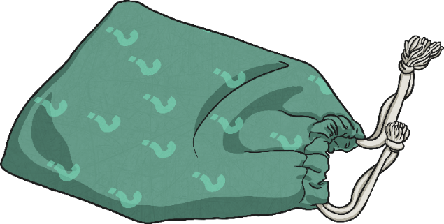


Describing Materials
Find 5 different materials around your house.
Think of words to describe each material, such as hard, soft, cold or rough.

Slide 4


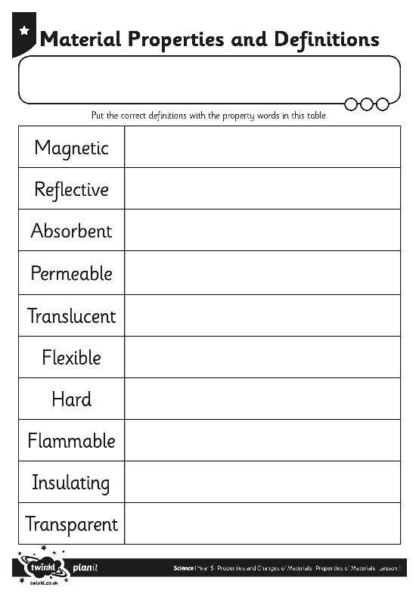
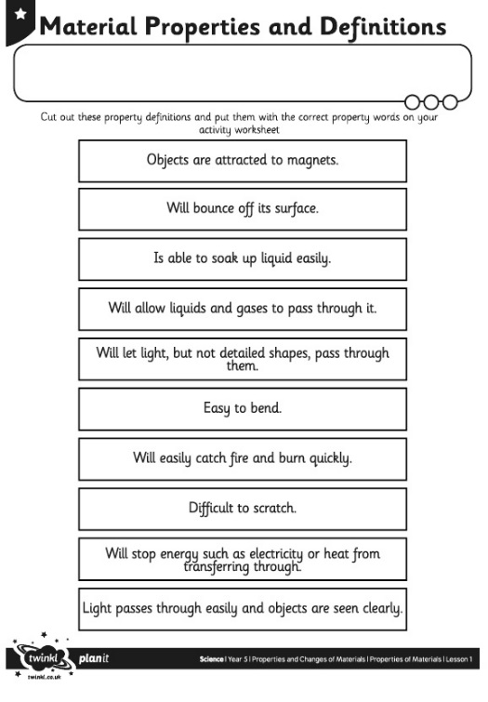
Properties
The words used to describe a material are known as its properties.
Each material has its
own set of properties.
These properties make different materials useful for
different purposes.
Can you match the properties with their definitions on your Material Properties
Activity Sheet? You can print this out or find an original way of showing this –chalk outside, as a poster- I’m sure you’ll find an even more original way! Don’t forget to photograph it and send it to us!

Slide 5

Using Materials
Why is it useful to know the properties of a material?
  It is useful because if you know the properties of a material, you can then choose the best material for a purpose.
  Look again at the objects you chose. Why was each material chosen to make these things?
.

