Slide 1
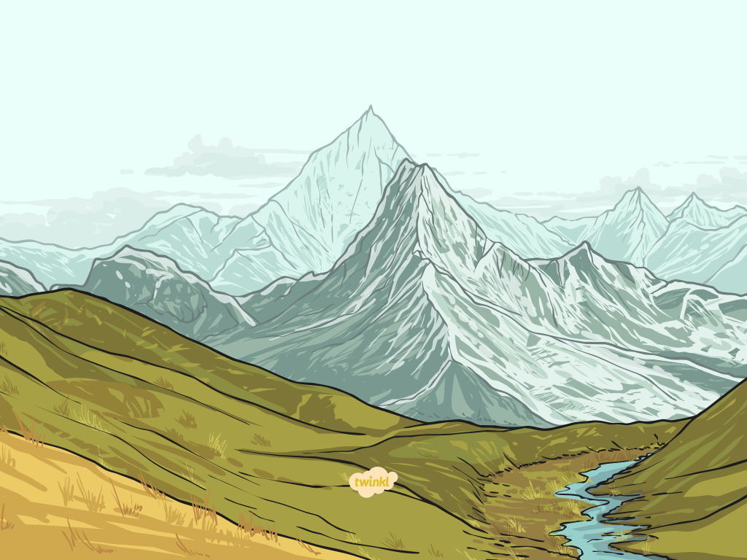
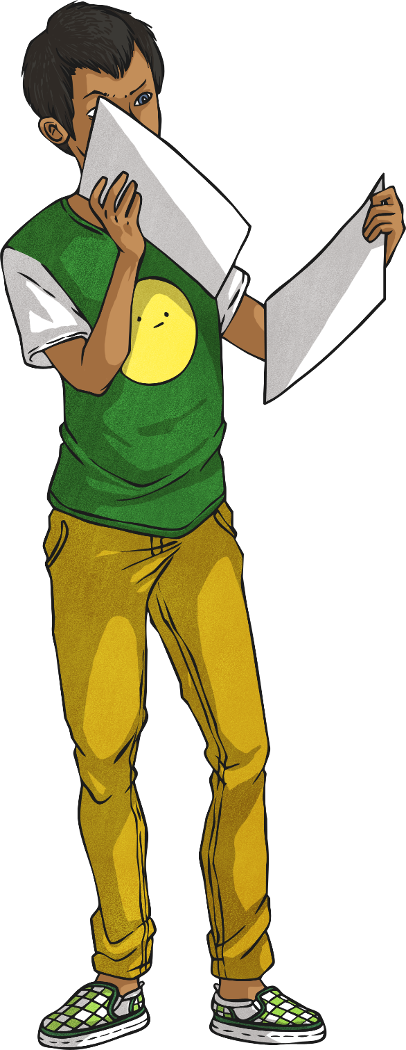
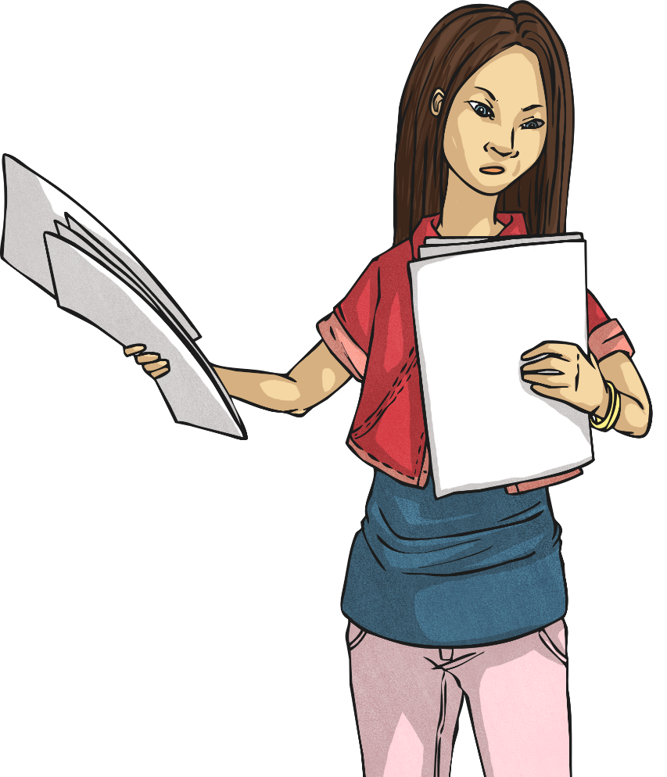
Les jours de la semaine
(Days of the Week)

Slide 2
DATE
LO: To name the days of the week in French
Success Criteria
I can listen carefully to a set of vocabulary.
I can understand, say and order the days of the week.

Slide 3



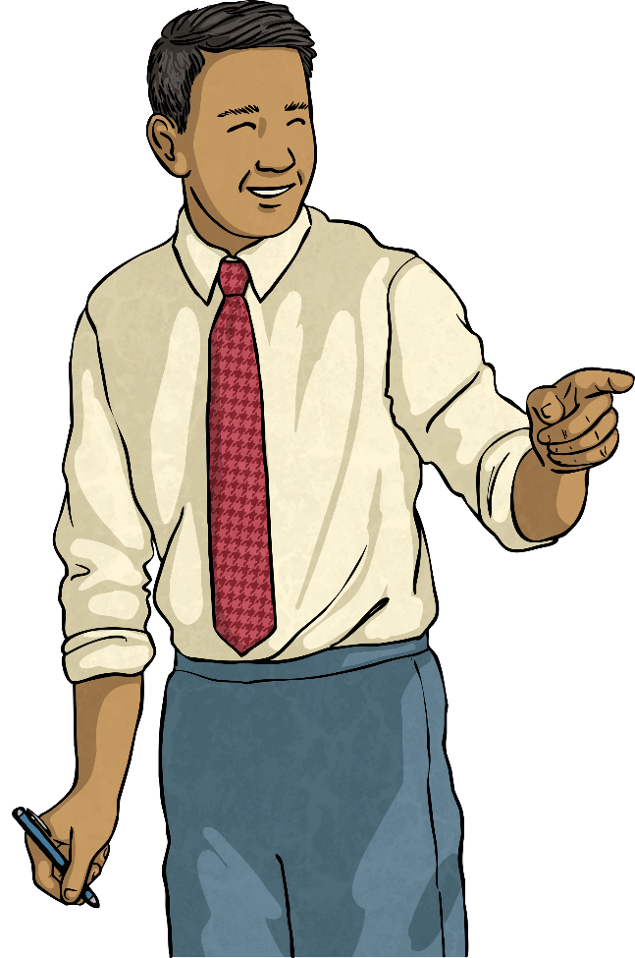
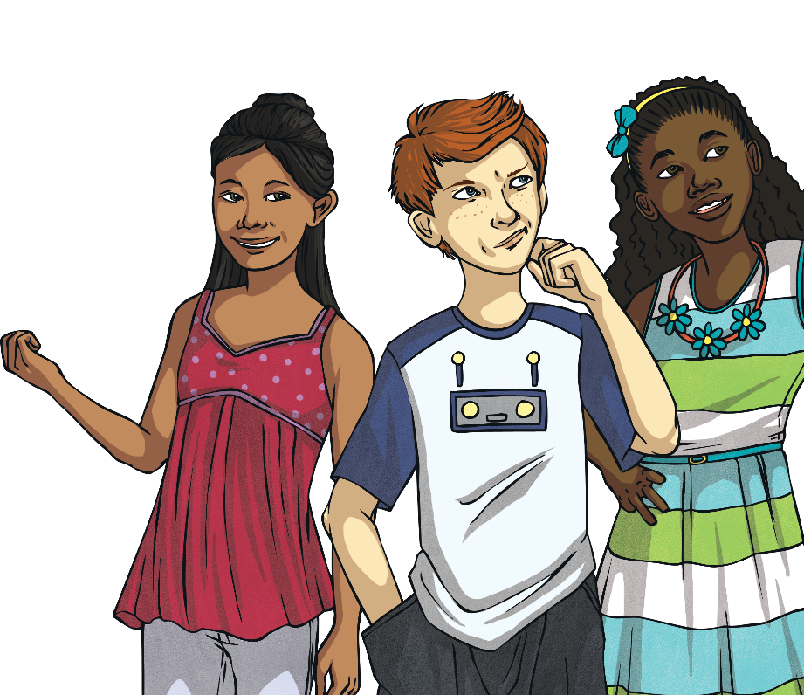
Number Fun!
quatorze !
Can you remember the numbers 0-31?
deux ?
How many days in a fortnight?
trente-et-un ?

Slide 4
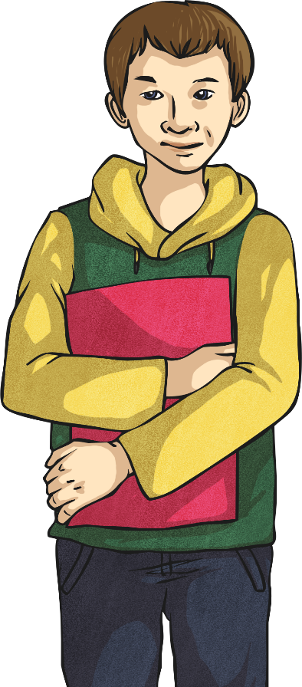
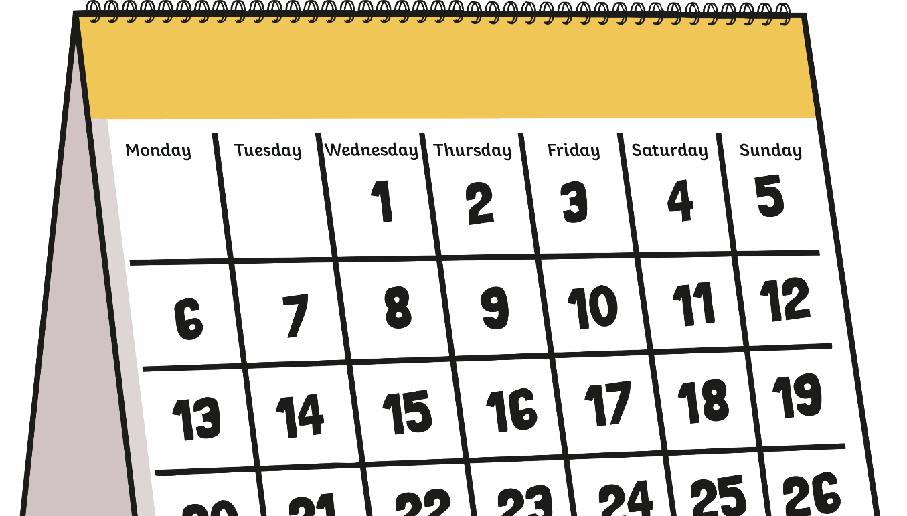
C’est quel jour ?
(What Day Is It?)
C’est quel jour ?
C’est lundi.

Slide 5
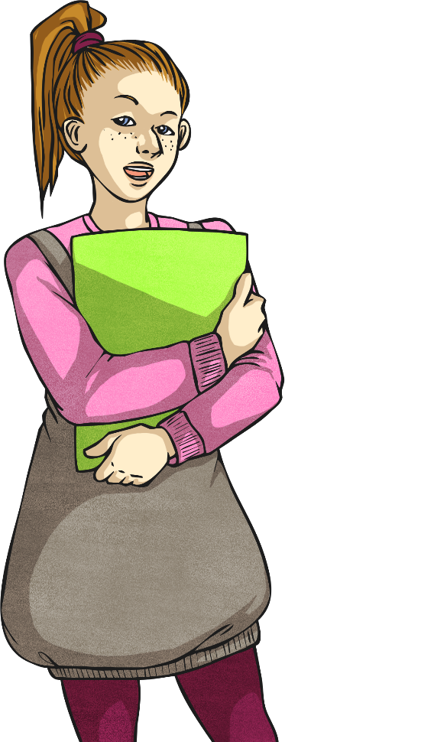
C’est quel jour ?
(What Day Is It?)
C’est quel jour ?
C’est mardi.

Slide 6
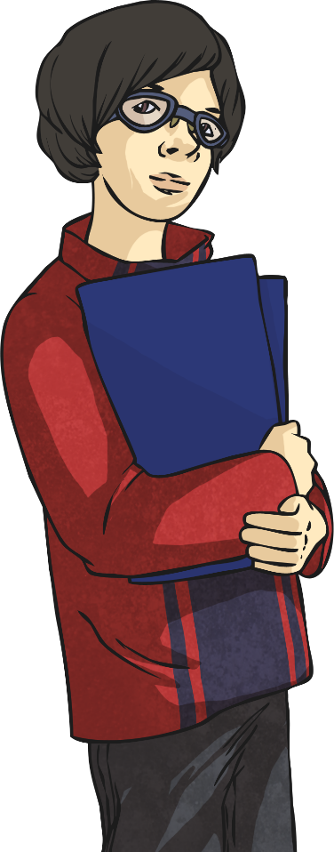
C’est quel jour ?
(What Day Is It?)
C’est quel jour ?
C’est mercredi.

Slide 7
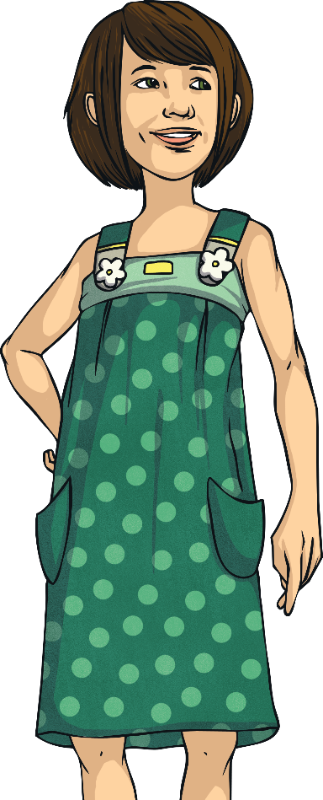
C’est quel jour ?
(What Day Is It?)
C’est quel jour ?
C’est jeudi.

Slide 8
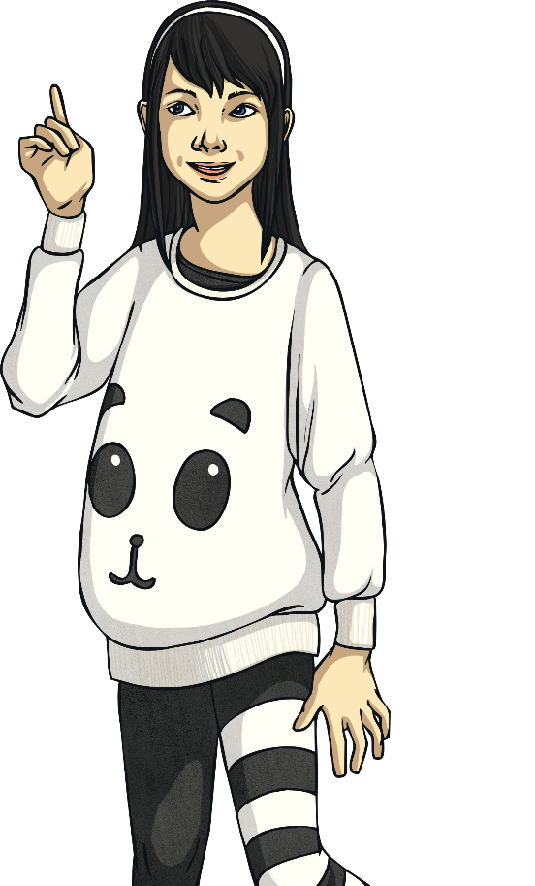
C’est quel jour ?
(What Day Is It?)
C’est quel jour ?
C’est vendredi.

Slide 9
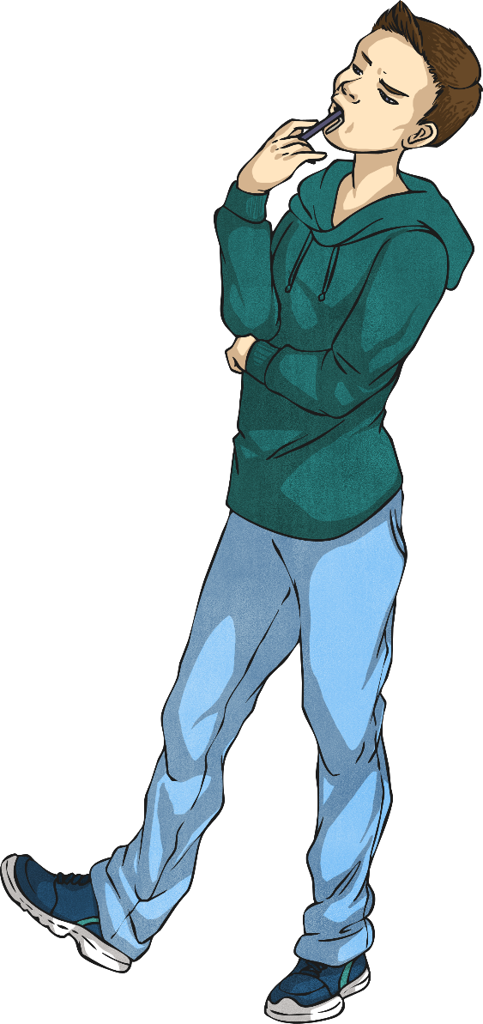
C’est quel jour ?
(What Day Is It?)
C’est quel jour ?
C’est samedi.

Slide 10
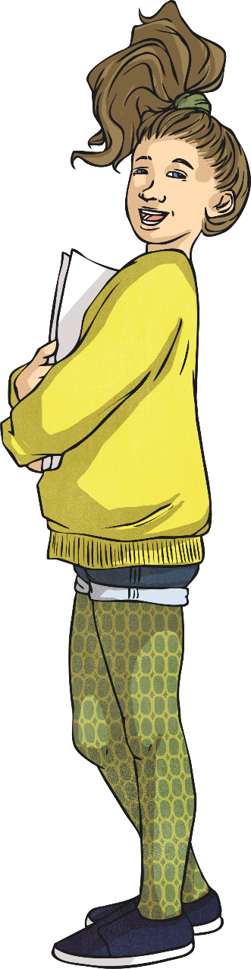
C’est quel jour ?
(What Day Is It?)
C’est quel jour ?
C’est dimanche.

Slide 11
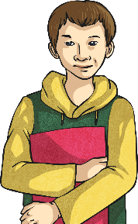






C’est quel jour ?
(What Day Is It?)
lundi
mardi
mercredi
jeudi
vendredi
samedi
dimanche

Slide 12
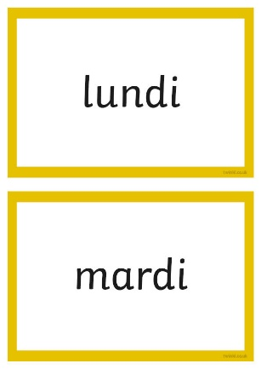
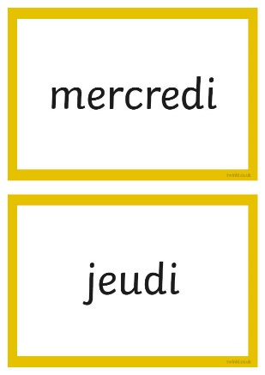

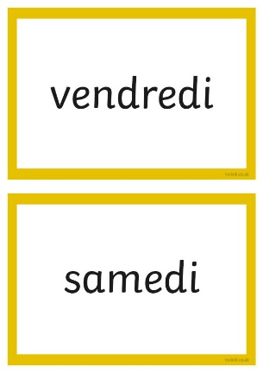
C’est quel jour ?
(What Day Is It?)
When I say a day you write the day in French on your board.

Slide 13

La semaine
(the week)
Qu’est-ce que c’est ?
C’est la semaine.

Slide 14
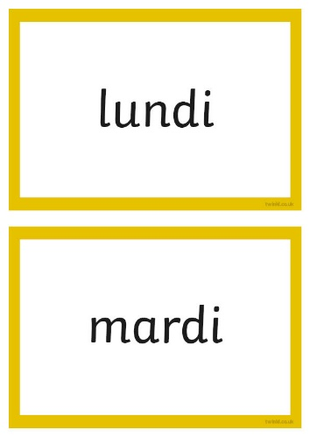
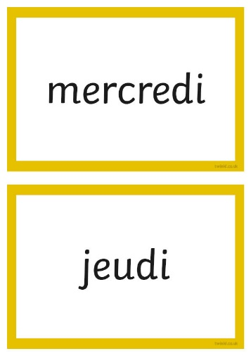

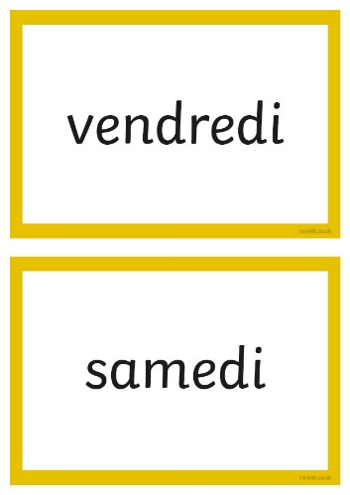
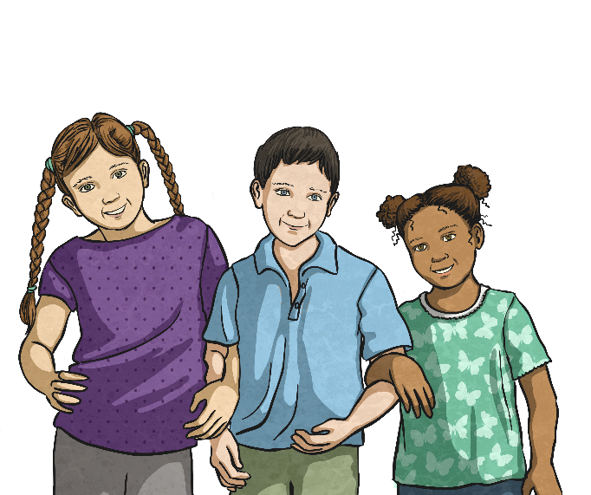
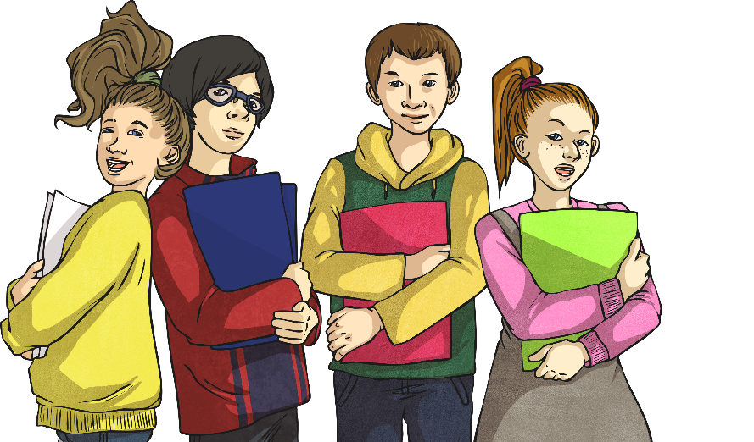
Faites la semaine
(Make a Week)
Put the cards in order for the days of the week.

