Slide 1
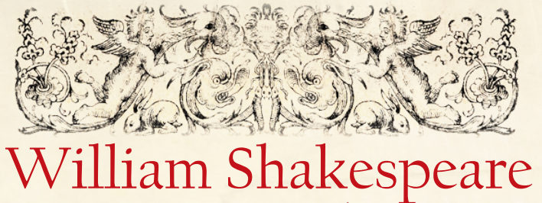

Slide 2
True or False?

Slide 3
True or False?
William Shakespeare was born on the 26th April 1564
False
This was the date William Shakespeare was baptised.

Slide 4
True or False?
His surviving works consist of
139 plays, 154 sonnets, three long narrative poems and several other poems.
False
His surviving works consist of 39 plays, 154 sonnets, three long narrative poems and several other poems.

Slide 5
True or False?
Shakespeare was born in Stratford-upon-Avon.
True

Slide 6
True or False?
Shakespeare married Anne Hathaway at the age of 28.
False
He was 18 when he married Anne Hathaway.

Slide 7
True or False?
Shakespeare’s family were all illiterate, and many people thought Shakespeare did not write his own work because of this.
True

Slide 8
True or False?
We don’t really know what Shakespeare actually looked like.
True

Slide 9
True or False?
Shakespeare’s company The King’s Men built the World Theatre.
False
The King’s Men built the Globe Theatre.

