Slide 1
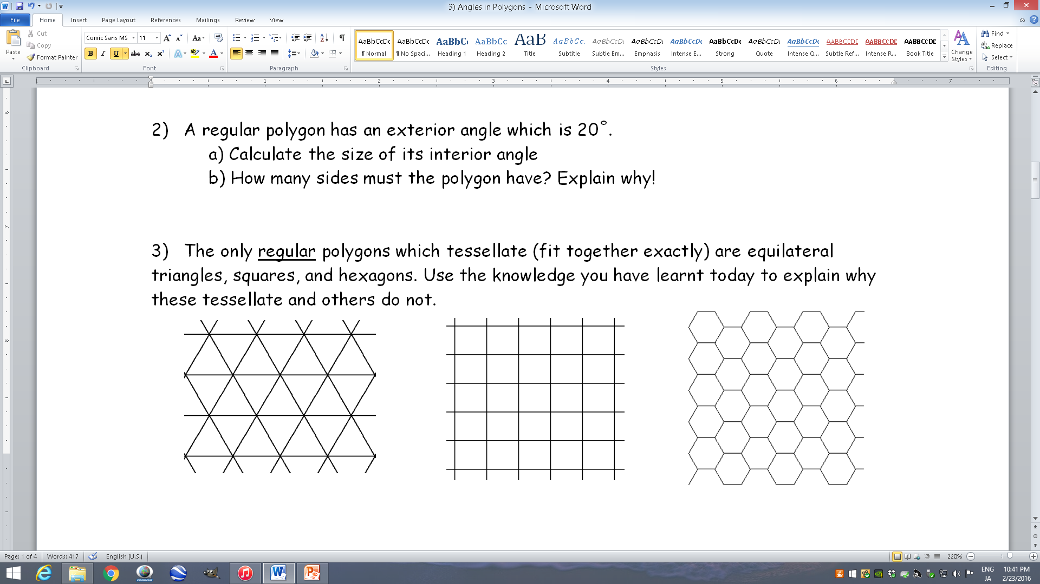
Angles in Polygons

Slide 2
Angles in Polygons
Today we will be looking at angles in polygons, more specifically, ‘regular’ polygons
A regular polygon is a polygon where all the sides are the same length, and all the angles are also equal
For example, an equilateral triangle and a square are regular polygons
Make sure you read questions as if you are told a polygon is regular, it is very helpful!
60˚
90˚
90˚
60˚
60˚
90˚
90˚

Slide 3
Angles in Polygons
Pairs of interior and Exterior angles add up to 180˚
To begin with, we need to define two key terms; Interior and Exterior angles
Interior angles are the angles inside a polygon
Exterior angles are the angles outside a polygon, that make a straight line with the interior angles
It doesn’t matter which way round you draw them!
If we combine the two diagrams…
…you can see that pairs of Interior Angles and Exterior Angles will always add up to 180˚

Slide 4








Angles in Polygons
Pairs of interior and Exterior angles add up to 180˚
Sum of Interior angles, where n is the number of sides
→ $180(n−2)$
The sum of the interior angles of a regular polygon can be calculated by considering how many triangles the polygon is made up of…
180˚
180˚
180˚
180˚
180˚
180˚
180˚
180˚
180˚
180˚
180˚
180˚
Pentagon
Hexagon
Heptagon
An ‘n’-gon (unspecified number of sides)
5 sides
6 sides
7 sides
$n$ sides
3 triangles
4 triangles
5 triangles
$(n – 2)$triangles
3 x 180
4 x 180
5 x 180
$(n – 2)$x 180
= 540˚
= 720˚
= 900˚
= $180(n – 2)$degrees

Slide 5



Angles in Polygons
Pairs of interior and exterior angles add up to 180˚
Sum of Interior angles, where n is the number of sides
→ $180(n−2)$
If regular, then divide by the number of angles to find what they all are!
If the shapes are regular, all the interior angles will be the same
→ We can then divide the sum of the interior angles, by how many angles the shape has!
108˚
120˚
120˚
128.6˚
?
128.6˚
128.6˚
108˚
108˚
120˚
120˚
128.6˚
128.6˚
108˚
108˚
120˚
120˚
128.6˚
128.6˚
An ‘n’-gon (unspecified number of sides)
Regular Pentagon
Regular Hexagon
Regular Heptagon
Regular ‘n’-gon
Sum of interior angles
= 540˚
Sum of interior angles
= 720˚
Sum of interior angles
= 900˚
Sum of interior angles
= $180(n – 2)$
5 angles
6 angles
7 angles
n angles
540 ÷ 5
720 ÷ 6
900 ÷ 7
$$180(n – 2)÷n$$
= 108˚
= 120˚
= 128.6˚
$$=\frac{180(n−2)}{n}$$

Slide 6
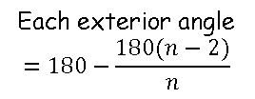
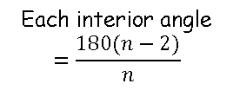
Angles in Polygons
Pairs of interior and exterior angles add up to 180˚
Sum of Interior angles, where n is the number of sides
→ $180(n−2)$
If regular, then divide by the number of angles to find what they all are!
If the shapes are regular, all the exterior angles will also be the same
→ Remember that the interior and exterior angles make a straight line together, so must add up to 180˚
72˚
60˚
51.4˚
51.4˚
108˚
60˚
120˚
120˚
128.6˚
?
72˚
128.6˚
128.6˚
60˚
51.4˚
108˚
108˚
120˚
120˚
51.4˚
72˚
60˚
128.6˚
128.6˚
108˚
108˚
72˚
120˚
120˚
60˚
51.4˚
128.6˚
128.6˚
51.4˚
72˚
60˚
51.4˚
Regular Pentagon
Regular Hexagon
Regular Heptagon
Regular ‘n’-gon
Each interior angle = 108˚
Each interior angle = 120˚
Each interior angle = 128.6˚
Each interior angle
$$=\frac{180(n−2)}{n}$$
Each exterior angle
= 180 - 108
Each exterior angle
= 180 - 120
Each exterior angle
= 180 – 128.6
Each exterior angle
$$=180−\frac{180(n−2)}{n}$$
= 72˚
= 60˚
= 51.4˚

Slide 7
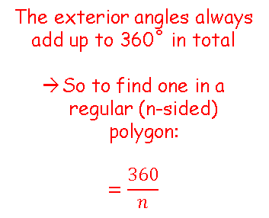
Angles in Polygons
Pairs of interior and exterior angles add up to 180˚
Sum of Interior angles, where n is the number of sides
→ $180(n−2)$
The exterior angles will always add up to 360 in total. Divide by the number of angles if a regular polygon!
If regular, then divide by the number of angles to find what they all are!
There is also an alternative way to work out the size of the exterior angles (for a regular shape), without needing the interior angle first…
72˚
60˚
51.4˚
51.4˚
60˚
?
72˚
60˚
51.4˚
72˚
51.4˚
60˚
72˚
60˚
51.4˚
51.4˚
72˚
60˚
51.4˚
Regular Pentagon
Regular Hexagon
Regular Heptagon
Regular ‘n’-gon
Each exterior angle = 72˚
Each exterior angle = 60˚
Each exterior angle = 51.4˚
The exterior angles always add up to 360˚ in total
So to find one in a regular (n-sided) polygon:
$$=\frac{360}{n}$$
5 exterior angles
6 exterior angles
7 exterior angles
72 x 5
60 x 6
51.4 x 7
= 360˚
= 360˚
= 360˚
(Remember that the 51.4 has been rounded)

Slide 8









Angles in Polygons
Pairs of interior and exterior angles add up to 180˚
Sum of Interior angles, where n is the number of sides
→ $180(n−2)$
The exterior angles will always add up to 360 in total. Divide by the number of angles if a regular polygon!
If regular, then divide by the number of angles to find what they all are!
Calculate the size of the interior angles and exterior angles in a regular dodecagon (12 sides)
Sum of the interior angles
Each interior angle
Number of sides = 12
$${1800}^{°}÷12$$
Calculate
$$180(n−2)$$
$$={150}^{°}$$
n = 12
$$=180(12−2)$$
Each exterior angle
Each exterior angle (alternative)
Calculate
bracket
$$=180(10)$$
$${180}^{°}−{150}^{°}$$
Number of sides = 12
Calculate
Calculate
$$={1800}^{°}$$
$$={30}^{°}$$
$${360}^{°}÷12$$
Calculate
$$={30}^{°}$$

