Slide 1
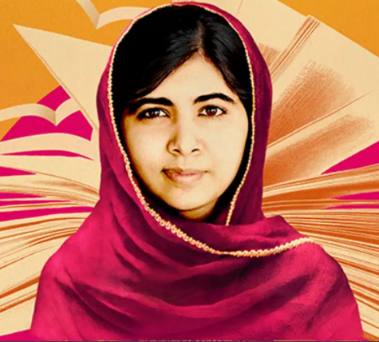
Monday 12th July 2021

Slide 2
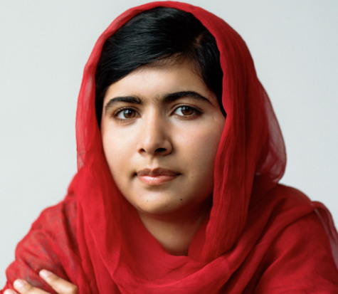
Malala Yousafai
https://malala.org/newsroom/archive/malala-un-speech

Slide 3
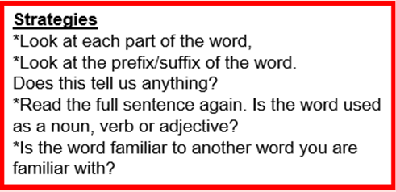
Glossary
Accountable
Enforced
Extremists
Nobel laureate
Harsh
Mingora
Poverty
Publicly
Swat Valley
Taliban

Slide 4
Glossary
Accountable | Completely responsible for what they do
Enforced | To make people obey a law, or to make a particular situation happen or be accepted
Extremists | Someone who has beliefs that most people think are unreasonable and unacceptable
Nobel laureate | A person or organisation awarded the Nobel Prize
Harsh | Unpleasant, unkind, cruel, or more severe than is necessary
Mingora | A city found in Swat Valley
Poverty | The state of being extremely poor.
Publicly | If something is done publicly, it is done so that everyone can know about it
Swat Valley | Swat, a scenic valley in northwestern Pakistan
Taliban | An Islamic political and military organisation, active in Afghanistan and Pakistan

Slide 5
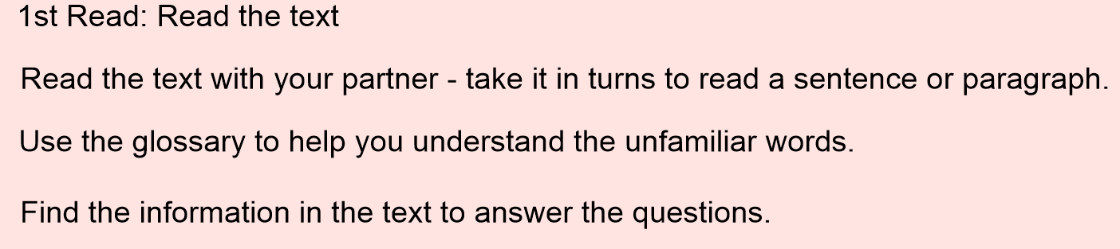
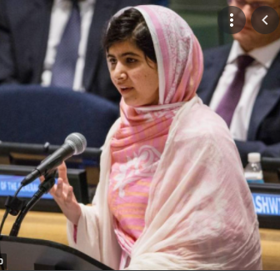
1st read

Slide 6
LO: To find information in the text to answer questions
Where was Malala born?
When is Malala birthday?
Who is Malala’s father?
Where did the Taliban take control?
How old was Malala when she said goodbye to her classmates?
6. What is the Malala Fund?
7. How many girls are out of school today?

Slide 7
LO: To find information in the text to answer questions
Where was Malala born? Malala was born in Mingora, Pakistan.
When is Malala birthday? Malala’s birthday is on July 12th.
Who is Malala’s father? Malala’s father is Ziauddin Yousafzai.
Where did the Taliban take control? The Taliban took control of Swat Valley.
How old was Malala when she said goodbye to her classmates?
Malala was 11 year old.
6. What is the Malala Fund? The Malala Fund is a charity dedicated to giving every girl an opportunity to achieve a future she chooses.
7. How many girls are out of school today? Over 130 million girls are out of school today.

