Slide 1
Can I talk about looking after God’s Wonderful World?

Slide 2
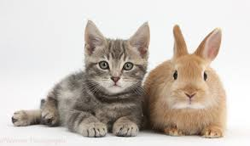

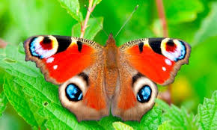
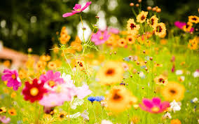
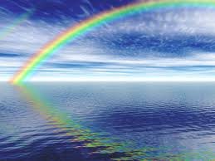

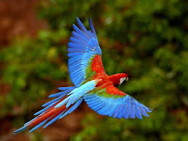

Slide 3
God created our wonderful world and then he made people to look after it.
Do we always look after it properly?
Talk to your partner about how you think God’s world is being spoilt.

Slide 4
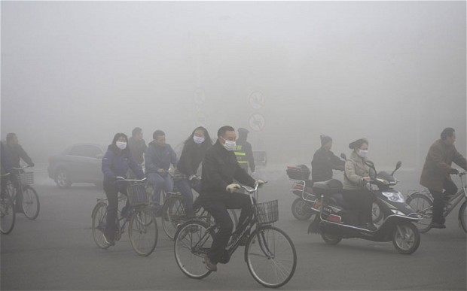
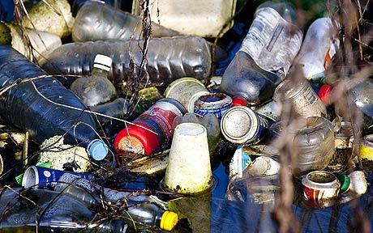
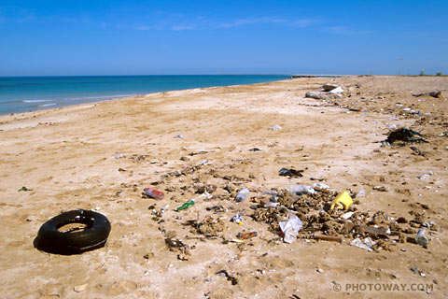
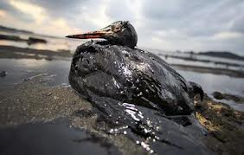
How is God’s world being spoilt?

Slide 5
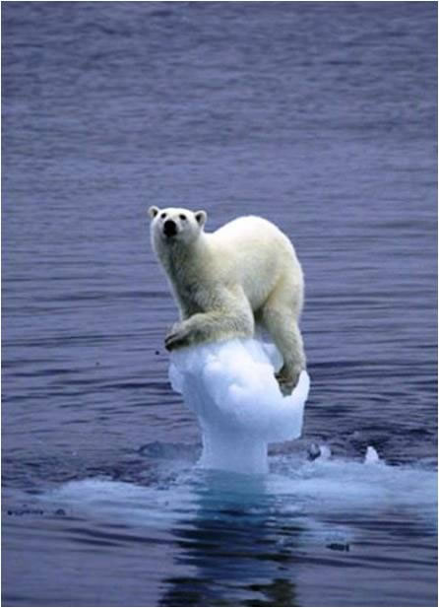
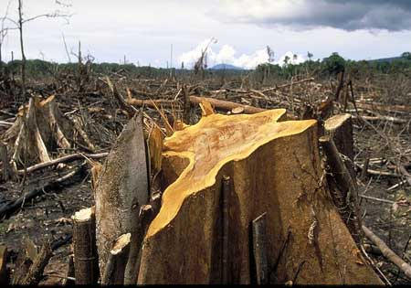
How is God’s world being spoilt?

Slide 6
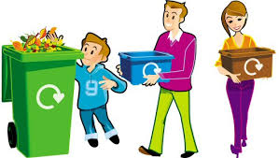
How can we help to look after the world?
Remember the 3 Rs
Reduce
Reuse
Recycle

Slide 7

What can we do to help?
Turn off the tap when brushing your teeth.

Slide 8
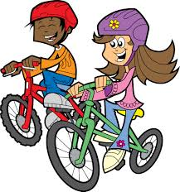
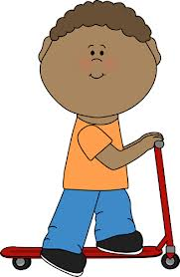
What can we do to help?
Don’t take the car if it’s not far!
Walking is better for our world and for you!
You could even ride your bike or scooter!

Slide 9


What can we do to help?
Don’t be a litterbug!
Put all your litter in the bin!

Slide 10

What can we do to help?
Save energy!
Turn off lights, computers and televisions when you are not using them.
Put on a jumper instead of turning up the heating.

Slide 11
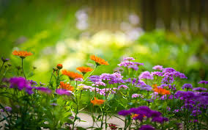
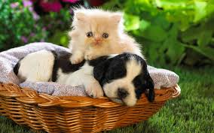
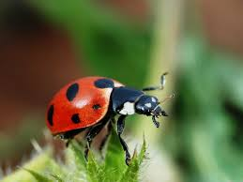
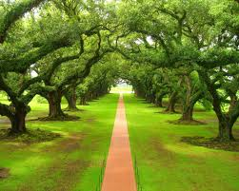
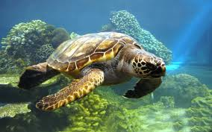
What can we do to help?
Take care of all the animals and plants.

Slide 12
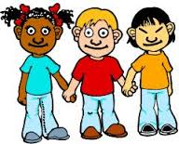
Who should look after the world?
All of us! We can all take responsibility for looking after God’s wonderful world and keeping it amazing.

Slide 13
Make a poster
Our amazing planet / Our wonderful world
Draw pictures / write captions to show what we can do to look after our wonderful world

