Slide 1

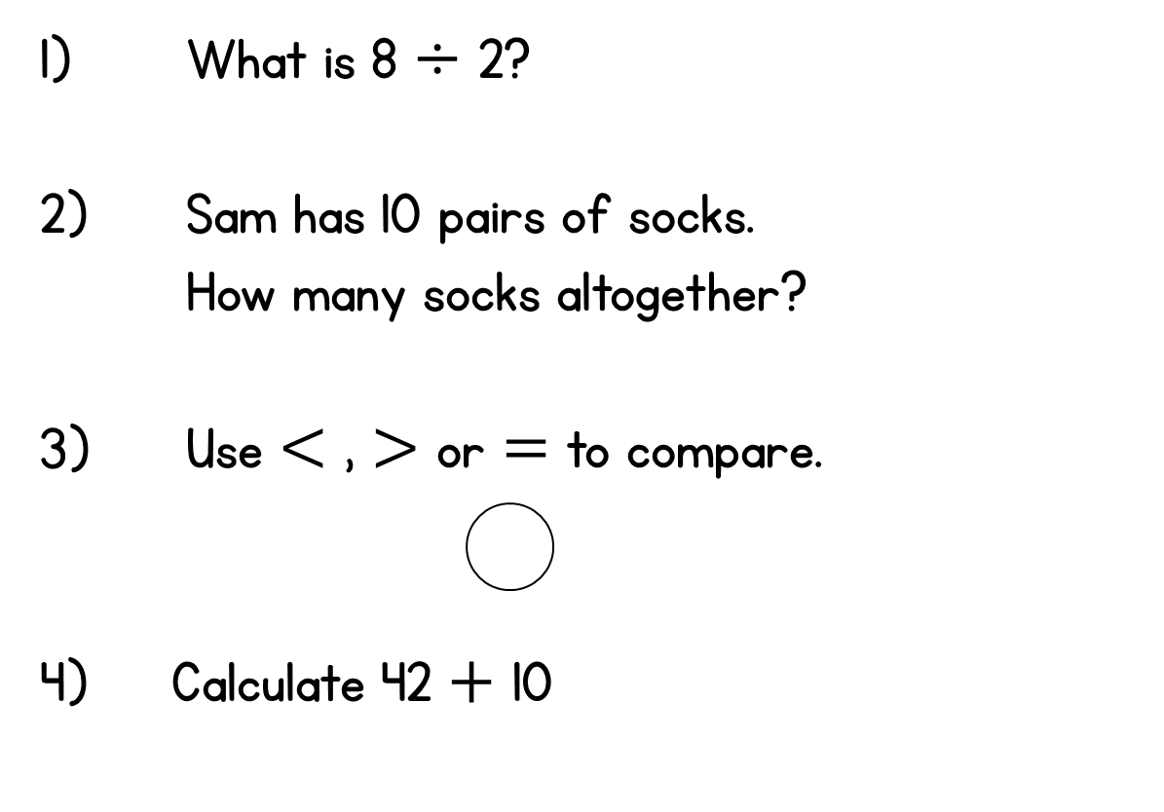
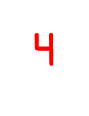
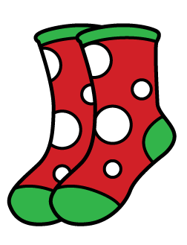

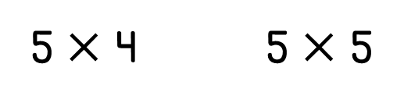

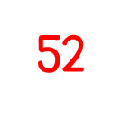

Slide 2
9.6.21
LO: To divide (grouping sharing numberline with 5)

Slide 3

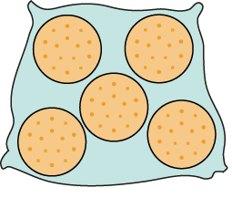
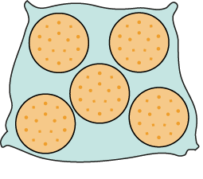

2.6 Quotitive and partitive division Step 2:6
15 biscuits in bags of 5. How many bags?
2 bags of 5 is 10.
3 bags of 5 is 15.
1 bag of 5 is 5.
15 ÷ 5
= 3
15 is divided into groups of 5. There are 3 groups.
15 divided into groups of 5 is equal to 3.
Notes:
There are fifteen biscuits.
If I put them into bags of five, how many bags will I need?
Quotitive (grouping) structure

Slide 4

2.6 Quotitive and partitive division Step 2:7
3 fives
+ 5
+ 5
+ 5
0
5
10
15
5 + 5 + 5 = 15
15 ÷ 5 = 3
15 divided into groups of 5 is equal to 3.
Notes:
Quotitive (grouping) structure

Slide 5


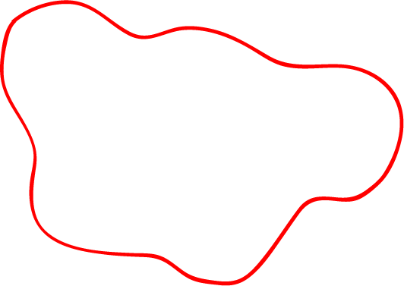
2.6 Quotitive and partitive division Step 2:7
3 fives
– 5
– 5
– 5
0
5
10
15
15 – 5 – 5 – 5 = 0
15 ÷ 5 = 3
15 divided into groups of 5 is equal to 3.
Notes:
Quotitive (grouping) structure

Slide 6



2.6 Quotitive and partitive division Step 2:9
30 cm ribbon. How many 5 cm lengths can be made?
30 ÷ 5
= 6
6 fives
+ 5
+ 5
+ 5
+ 5
+ 5
+ 5
5 + 5 + 5 + 5 + 5 + 5 = 30
Notes:
A dressmaker has a ribbon that is thirty centimetres long. She needs five-centimetre lengths.
How many five-centimetre lengths can she make?
Quotitive (grouping) structure

Slide 7



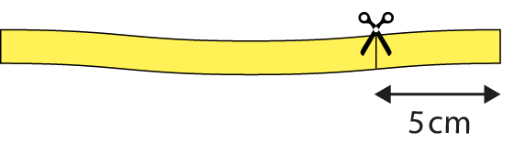
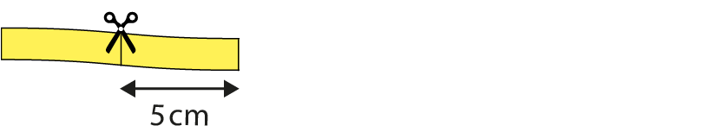
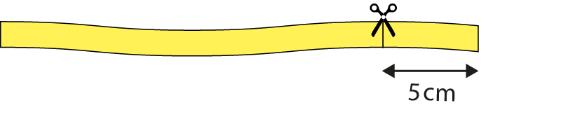
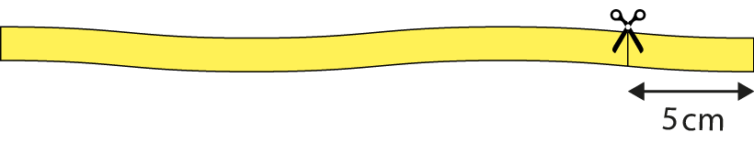

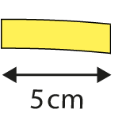
2.6 Quotitive and partitive division Step 2:9
30 cm ribbon. How many 5 cm lengths can be made?
= 6
30 ÷ 5
6 fives
– 5
– 5
– 5
– 5
– 5
– 5
30 – 5 – 5 – 5 – 5 – 5 – 5 = 0
Notes:
A dressmaker has a ribbon that is thirty centimetres long. She needs five-centimetre lengths.
How many five-centimetre lengths can she make?
Quotitive (grouping) structure

Slide 8
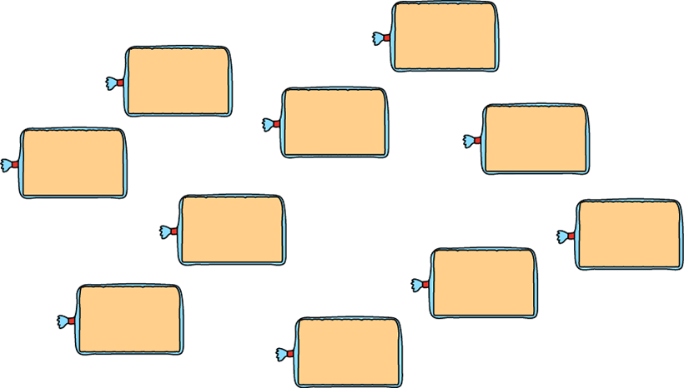





2.6 Quotitive and partitive division Step 2:11
10 loaves, 5 in each bag. How many bags?
= 2
10 ÷ 5
10 divided into groups of 5 is equal to 2.
Notes:
I go into a bakery to buy ten loaves of bread.
I can fit five loaves of bread into each bag. How many bags will I need?
Quotitive (grouping) structure

Slide 9
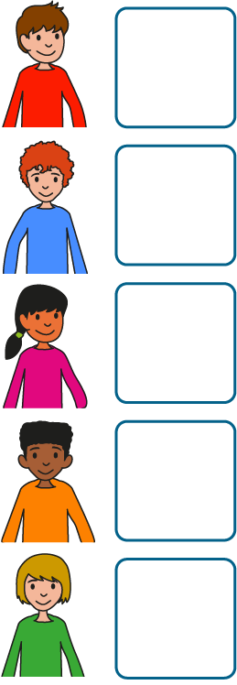

2.6 Quotitive and partitive division Step 3:1
20 conkers, shared equally between 5 children. How many each?
Each child gets 4 conkers.
Notes:
I have twenty conkers and I share them equally between five children.
How many conkers does each child get ?
Partitive (sharing) structure

Slide 10


2.6 Quotitive and partitive division Step 3:3
5 balloons shared equally between 5 children. How many each?
5 ÷ 5
= 1
1 five is 1 each.
Notes:
There are five balloons. If they are shared equally between
five children, how many balloons does each child get?
Partitive (sharing) structure

Slide 11
2.6 Quotitive and partitive division Step 3:3
10 balloons shared equally between 5 children. How many each?
10 ÷ 5
= 2
2 fives is 2 each.
1 five is 1 each.
Notes:
There are ten balloons. If they are shared equally between
five children, how many balloons does each child get?
Partitive (sharing) structure

Slide 12

2.6 Quotitive and partitive division Step 3:5
20 conkers shared equally between 5 children. How many each?
20 ÷ 5
= 4
1 five is 1 each.
2 fives is 2 each.
3 fives is 3 each.
4 fives is 4 each.
Notes:
I have twenty conkers and I share them equally between five children.
How many conkers does each child get?
Partitive (sharing) structure

Slide 13




2.6 Quotitive and partitive division Step 3:6
20 ÷ 5 = 4
+ 5
+ 5
+ 5
+ 5
Notes:
Partitive (sharing) structure

Slide 14



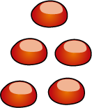



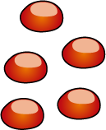
2.6 Quotitive and partitive division Step 3:6
– 5
– 5
– 5
– 5
20 ÷ 5 = 4
Notes:
Partitive (sharing) structure

Slide 15

2.6 Quotitive and partitive division Step 3:8
10 loaves, shared equally between 5 bags. How many in each bag?
10 ÷ 5
= 2
10 divided between 5 is equal to 2 each.
Notes:
I go into a bakery to buy ten loaves of bread. I have five shopping bags.
If I share the loaves of bread equally between the bags, how many will there be in each bag?
Partitive (sharing) structure

Slide 16

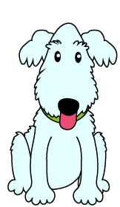





2.6 Quotitive and partitive division Step 3:9
2 packs of bones, 5 bones in each pack.
How many bones for each dog?
2 each
Notes:
There are five dogs and some packs of bones. Each pack contains five bones.
How many bones does each dog get if there are two packs of bones?
Partitive (sharing) structure

Slide 17


2.6 Quotitive and partitive division Step 3:9
5 packs of bones, 5 bones in each pack.
How many bones for each dog?
5 each
Notes:
How many bones does each dog get if there are five packs of bones?
Partitive (sharing) structure

Slide 18
We do
Using sharing and grouping show me:
30 ➗ 5 =

Slide 19
You do
Work out these problems using ‘grouping’.
Use ‘sharing’ to check your answer.
25 ➗ 5 =
15 ➗ 5 =
45 ➗ 5 =
60 ➗ 5 =

Slide 20
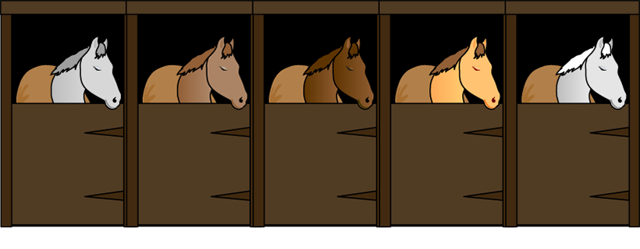


2.6 Quotitive and partitive division Step 3:9
If the apples are shared equally, each horse gets 5. True or false?
False
Notes:
The apples are shared equally between the horses.
Ulyana says each horse gets five apples. Is she correct?
Partitive (sharing) structure

