Slide 1

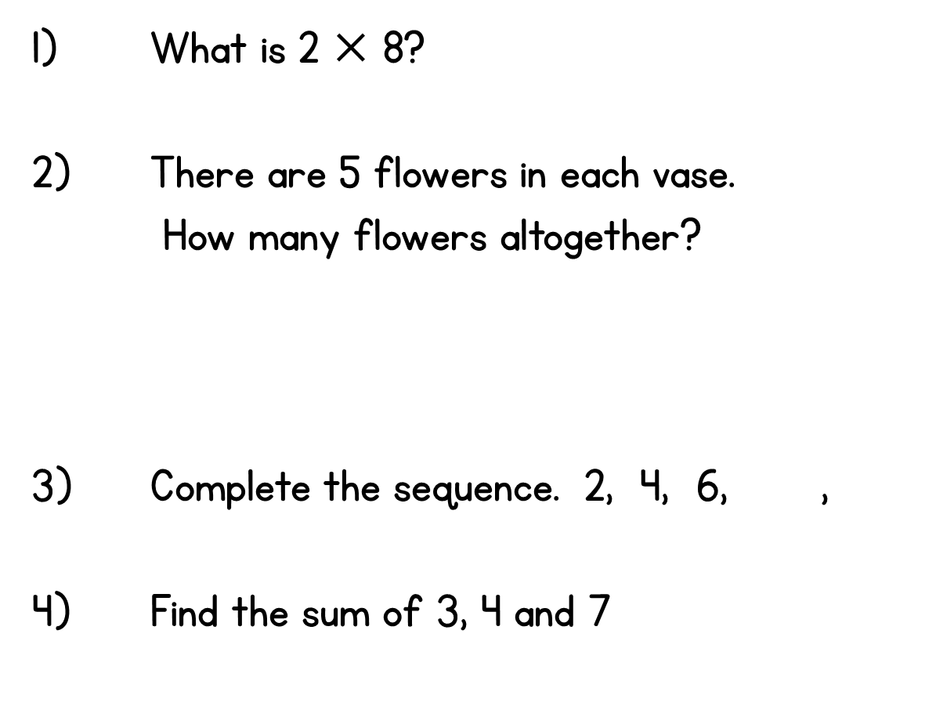






Slide 2
7.6.21
LO: To use the division symbol

Slide 3



2.6 Quotitive and partitive division Step 2:1
8 socks, how many pairs?
8 is divided into groups of 2. There are 4 groups.
There are 4 groups of 2 in 8.
Notes:
Quotitive (grouping) structure

Slide 4

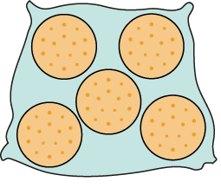
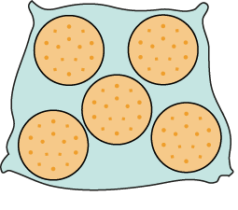

2.6 Quotitive and partitive division Step 2:2
15 biscuits, 5 in a bag. How many bags?
15 is divided into groups of 5.
There are 3 groups.
There are 3 groups of 5 in 15.
Notes:
There are fifteen biscuits. If I put them into bags of five, how many bags will I need?
Quotitive (grouping) structure

Slide 5
2.6 Quotitive and partitive division Step 2:2
15 biscuits, 5 in a bag. How many bags?
x 5 = 15
Notes:
Quotitive (grouping) structure

Slide 6
2.6 Quotitive and partitive division Step 2:3
15 ÷ 5
Notes:
We can represent this as fifteen divided into groups of five.
Quotitive (grouping) structure

Slide 7



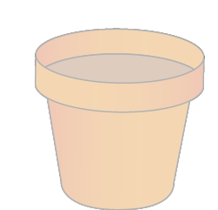

2.6 Quotitive and partitive division Step 2:4
14 seeds, 2 in each pot. How many pots?
14 divided into groups of 2.
14 ÷ 2
Notes:
There are fourteen seeds. Two seeds are planted in each pot.
How many pots are needed?
Quotitive (grouping) structure

Slide 8





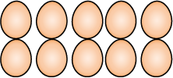
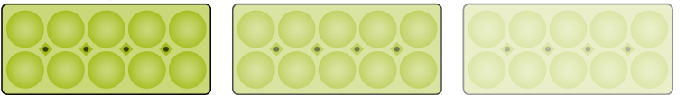


2.6 Quotitive and partitive division Step 2:4
40 eggs, 10 in a box. How many boxes?
40 divided into groups of 10.
40 ÷ 10
Notes:
A farmer has forty eggs. She can fit ten eggs in a box.
How many boxes does she need?
Quotitive (grouping) structure

Slide 9

2.6 Quotitive and partitive division Step 2:5
16 children, how many pairs?
We can represent this as 16 divided into groups of .
2
16 ÷ 2
Notes:
There are sixteen children. The children get into pairs.
How many pairs will there be?
Quotitive (grouping) structure

Slide 10
2.6 Quotitive and partitive division Step 2:6
15 biscuits in bags of 5. How many bags?
2 bags of 5 is 10.
3 bags of 5 is 15.
1 bag of 5 is 5.
15 ÷ 5
= 3
15 is divided into groups of 5. There are 3 groups.
15 divided into groups of 5 is equal to 3.
Notes:
There are fifteen biscuits.
If I put them into bags of five, how many bags will I need?
Quotitive (grouping) structure

Slide 11

We do
Complete the following sentences:
(Use the resources to help you)
There are ______ sweets.
They are put into bags of ________.
______ divided into groups of _______ is _________.
______ ➗ ______ = ________

Slide 12
You do

