Slide 1

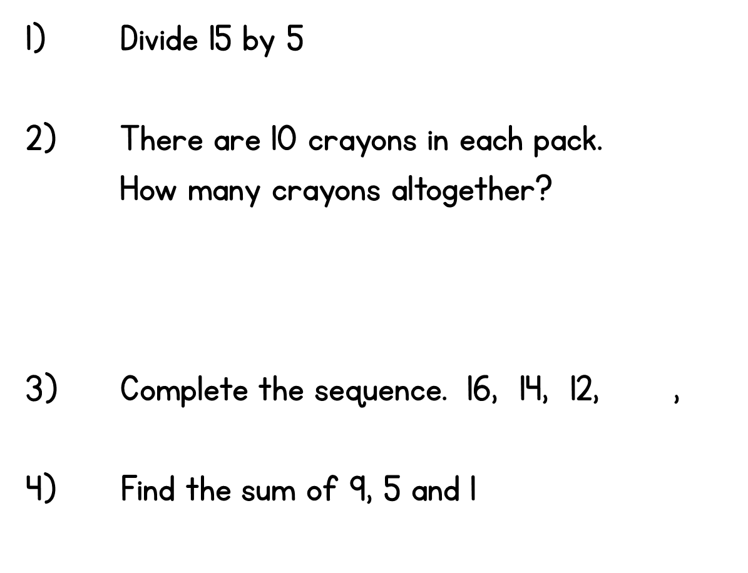




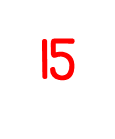
Year 2 | Week 1 | Day 2

Slide 2
8.6.21
LO: To divide (grouping sharing numberline with 2)

Slide 3













2.6 Quotitive and partitive division Step 2:8
8 balloons, 2 to each child. How many get balloons?
3 twos are 6.
2 twos are 4.
4 twos are 8.
1 two is 2.
Notes:
I have eight balloons. I give two balloons to each child.
How many children get balloons?
Quotitive (grouping) structure

Slide 4






2.6 Quotitive and partitive division Step 2:8
2 + 2 + 2 + 2 = 8
4 twos
+ 2
+ 2
+ 2
+ 2
Notes:
Quotitive (grouping) structure

Slide 5
2.6 Quotitive and partitive division Step 2:8
8 – 2 – 2 – 2 – 2 = 0
4 twos
– 2
– 2
– 2
– 2
Notes:
Quotitive (grouping) structure

Slide 6
2.6 Quotitive and partitive division Step 2:8
4 twos
+ 2
+ 2
+ 2
+ 2
– 2
– 2
– 2
– 2
8 is divided into groups of 2. There are 4 groups.
8 ÷ 2 = 4
8 divided into groups of 2 is equal to 4.
So, 4 children get balloons.
Notes:
Quotitive (grouping) structure

Slide 7






2.6 Quotitive and partitive division Step 2:11
10 loaves, 2 in each bag. How many bags?
= 5
10 ÷ 2
10 divided into groups of 2 is equal to 5.
Bags:
Notes:
I go into a bakery to buy ten loaves of bread.
I can fit two loaves of bread into each bag. How many bags will I need?
Quotitive (grouping) structure

Slide 8


2.6 Quotitive and partitive division Step 3:2
24 bean bags, shared equally between 2 teams.
How many for each team?
We can represent this as 24 divided between 2.
24 ÷ 2
= 12
24 divided between 2 is equal to 12 each.
Team A
Team B
Notes:
There are twenty-four bean bags. If they are shared equally between
two teams, how many bean bags does each team get?
Partitive (sharing) structure

Slide 9
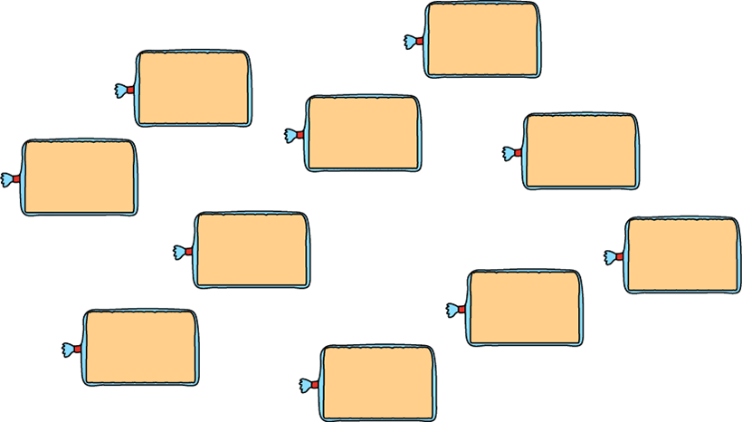



2.6 Quotitive and partitive division Step 3:8
10 loaves, shared equally between 2 bags. How many in each bag?
10 ÷ 2
= 5
10 divided between 2 is equal to 5 each.
Notes:
I go into a bakery to buy ten loaves of bread. I have two shopping bags.
If I share the loaves of bread equally between the bags, how many in each bag?
Partitive (sharing) structure

Slide 10







2.6 Quotitive and partitive division Step 3:9
2 packs of bones, 5 bones in each pack.
How many bones for each dog?
2 each
Notes:
There are five dogs and some packs of bones. Each pack contains five bones.
How many bones does each dog get if there are two packs of bones?
Partitive (sharing) structure

Slide 11


2.6 Quotitive and partitive division Step 3:9
5 packs of bones, 5 bones in each pack.
How many bones for each dog?
5 each
Notes:
How many bones does each dog get if there are five packs of bones?
Partitive (sharing) structure

Slide 12
We do
What is the difference between grouping and sharing?
Which questions is dividing into groups?
Which question is dividing by sharing?
Sally has 10 biscuits. She gives biscuits to each of her 5 friends. How many biscuits do they get each?
There are 15 biscuits in the tin. They are put into bags of 3. How many bags are there?

Slide 13
You do
16 ➗ 2 =
20 ➗ 2 =
28 ➗ 2 =

Slide 14
You do
14 ➗ 2 =
22 ➗ 2 =
8 ➗ 2 =
26 ➗ 2 =

Slide 15



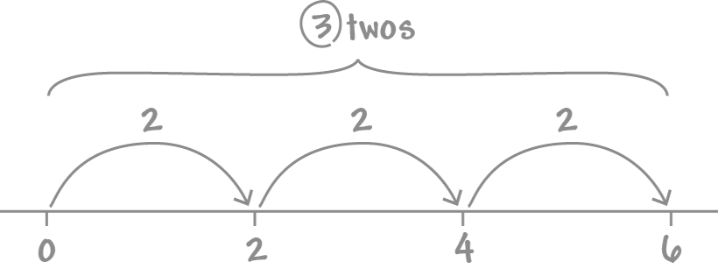
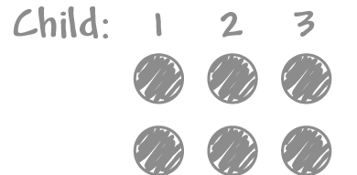
Challenge
6 stickers shared between 2 children. How many each?
Jacinta writes:
Toby writes:
✓
✗
They get 3 each.
They get 2 each.
Who is correct? Why?
Notes:
Six stickers are shared between two children.
How many stickers does each child get?
Partitive (sharing) structure

